Slide 1

Board of Trustees
Executive Committee
August 2022

Slide 2
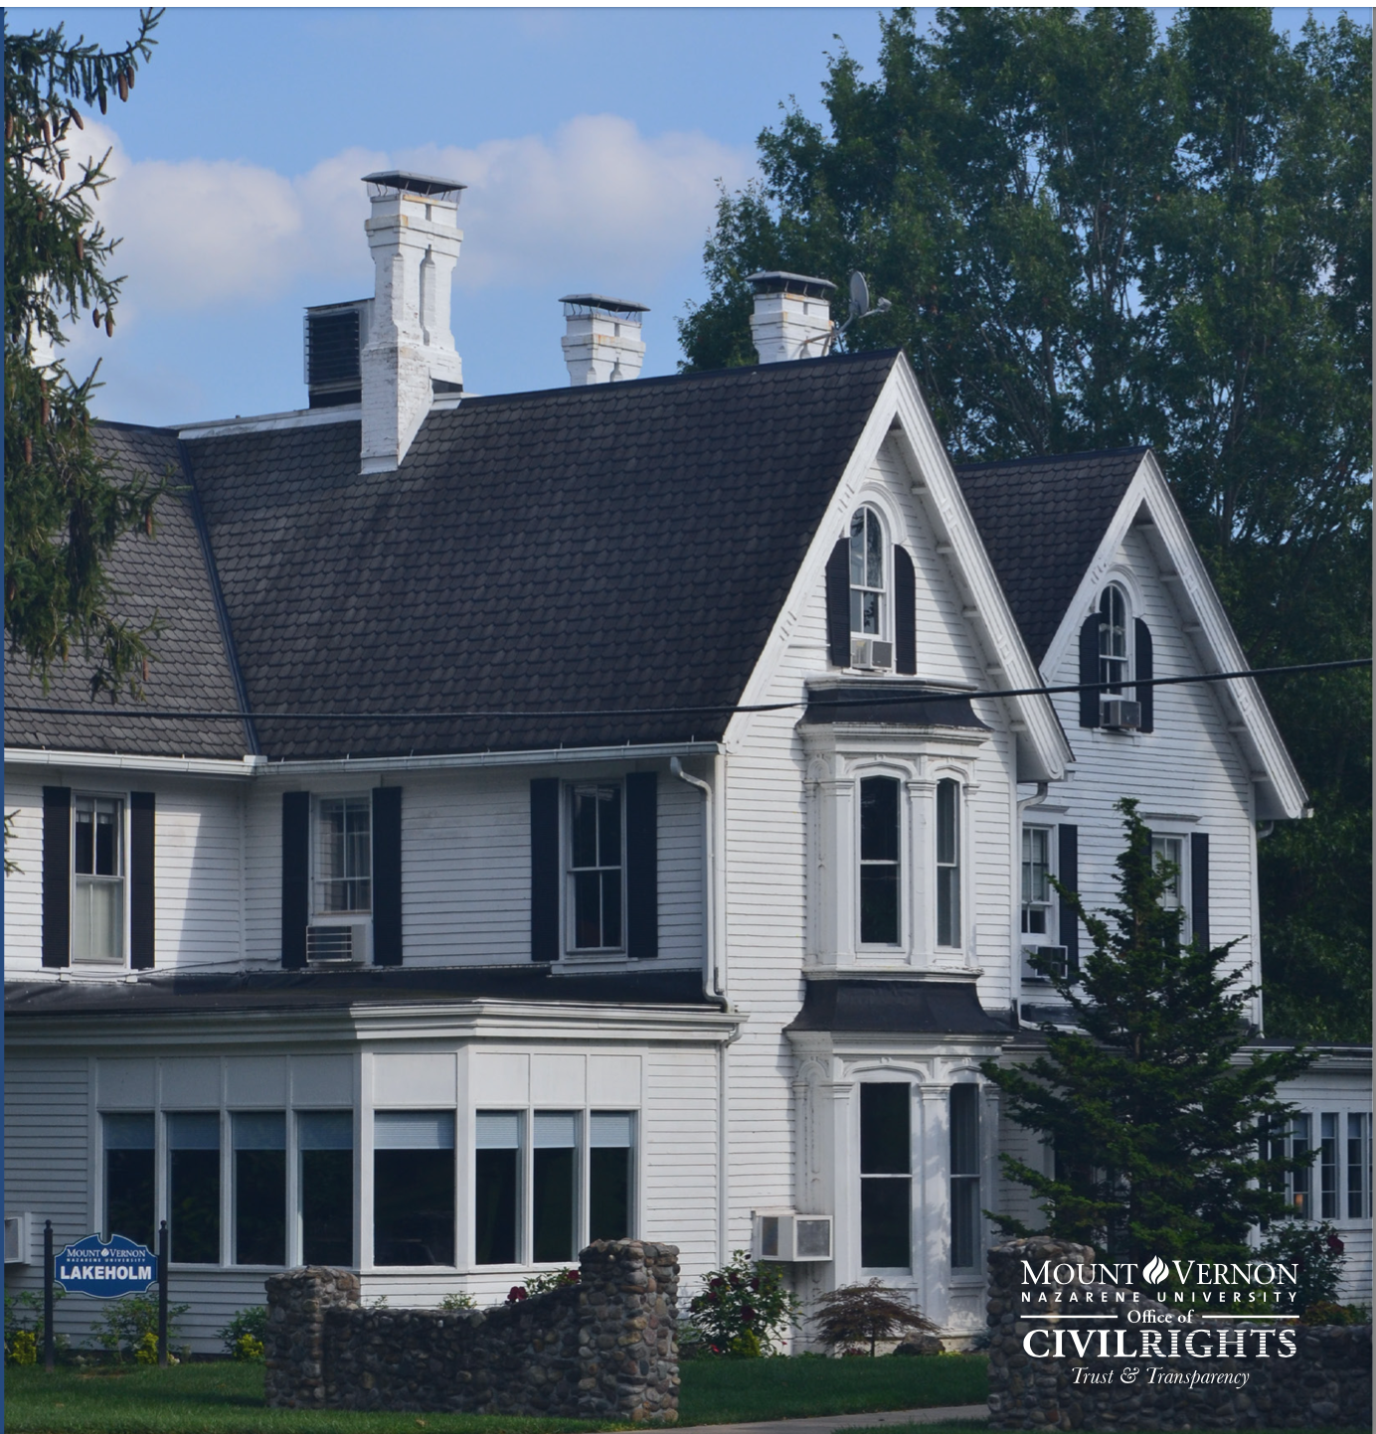
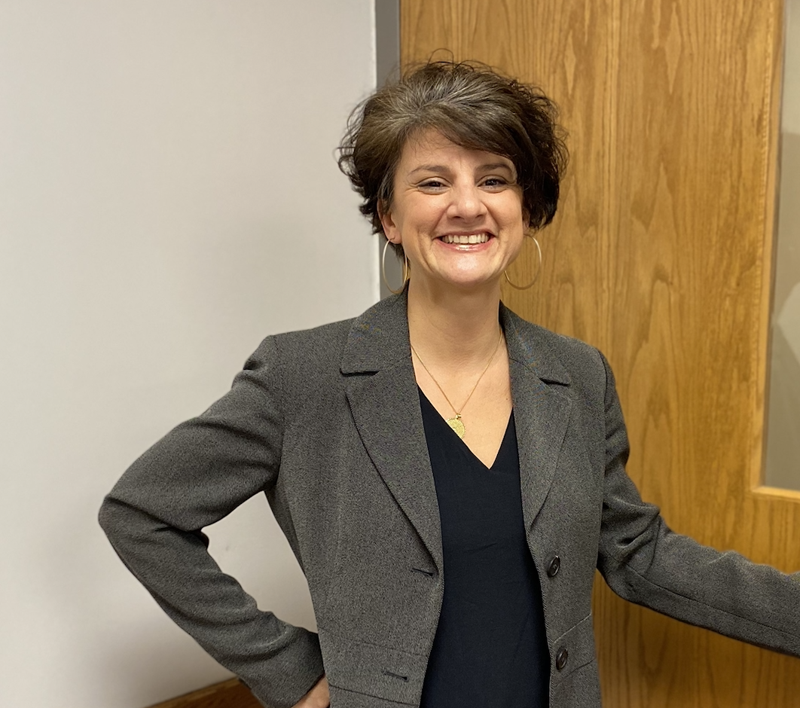
Civil Rights Office
Civil Rights Director
Christina Jones, J.D.
Lakeholm 109

Slide 3

Who We Are and What We Believe
- Manual Statements
“[T]he distinctive mission of the Church of the Nazarene,” [is] namely “to spread scriptural holiness . . . [as] the key element in a core of nonnegotiables which represent the Nazarene identity.”
“The Nazarene founders invested significantly in higher education, believing it essential for training pastors and other Christian workers and for shaping the laity.”
Grounded in the Wesleyan tradition, Nazarenes understand themselves to be a people who are Christian, Holiness, and Missional, and embrace as their mission statement: “To make Christlike disciples in the nations.”

Slide 4

Scripture supports our mission
“You, my brothers and sisters, were called to be free. But do not use your freedom to indulge the flesh; rather, serve one another humbly in love. For the entire law is fulfilled in keeping this one command: “Love your neighbor as yourself.”
Gal. 5:13-14 (NIV)

Slide 5
Who We Are and What We Believe
- Manual Statements
The Church of the Nazarene recognizes that there are current moral and social issues that must be addressed as expanded upon within the Manual of the Church of the Nazarene.
  Discrimination, 915
  Abuse of the Unempowered, 916
  Affirmation and Declaration of Human Freedom, 920
  Value of Children and Youth, 921
  Creation Care, 924
  Pornography, 926
  Wellness, 928
  Alcohol Desocialization, 929
  Use of Social Media, 933
How we love our neighbor!

Slide 6
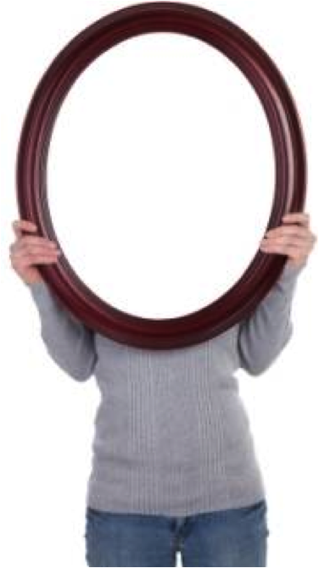
We live in a fallen world with broken people ---- MVNU is made up of these people!
We must consider these current and social issues.
Now we know that whatever the law says, it says to those who are under the law, so that every mouth may be silenced and the whole world held accountable to God. Therefore no one will be declared righteous in God’s sight by the works of the law; rather, through the law we become conscious of our sin. Romans 3:19-20
According to William M. Greathouse:
“the law is God’s mirror.”
Obeying the federal law AND the Great Commission –
to make Christlike disciples.
“Preach the word of God. Be prepared, whether the time is favorable or not. Patiently correct, rebuke, and encourage your people with good teaching.”
2 Tim. 4:2 (NLT)

Slide 7
It is both our legal duty and our moral obligation to foster a non-discriminatory campus environment because we are an intentionally Christian community where it’s members should be able to flourish in their learning or working environments.
2 Civil Rights Policies
Discrimination, Harassment, Sexual Misconduct
Resolving Complaints under ADA/Section 505
Find these at www.mvnu.edu/titleix

Slide 8

Notice of Non-Discrimination
Mount Vernon Nazarene University is committed to fostering a non-discriminatory campus environment in which community members can learn and work. MVNU prohibits discrimination on the basis of race, sex, age, color, national origin, disability, marital status, or military service in the operation of all University programs, activities, and services. As a faith-based institution, the University is exempted from certain laws and regulations concerning discrimination. The University maintains the right, with regard to its lifestyle covenant, employment, and other matters, to uphold and apply its Christian beliefs related to, among other issues, marriage, sex (gender), gender identity, sexual orientation, and sexual activity to the fullest extent permitted by law. Thus, MVNU attempts to make all policies and decisions within the doctrinal and moral convictions of the Church of the Nazarene (e.g., Articles of Faith, Covenant of Christian Conduct including the Statement on Human Sexuality and Marriage, Covenant of Christian Character, and the Statement on Discrimination, 915).

Slide 9

Religious Expression
Who We Are and What We Believe
Being of Wesleyan heritage, and a ministry of the Church of the Nazarene, we strive to be a learning community where grace is foundational, truth is pursued, and holiness is a way of life. Furthermore, we attempt to make all policies and decisions within the doctrinal and moral convictions of the Church of the Nazarene as articulated within the Manual of the Church of the Nazarene (e.g., Articles of Faith, Covenant of Christian Conduct including the Statement on Human Sexuality and Marriage, Covenant of Christian Character, and the agreed upon Statement on Discrimination, 915). We also strive to provide a learning and living environment that promotes safety, transparency, personal integrity, civility, mutual respect and freedom from unlawful discrimination.
This integration of faith and learning is recognized by the United States and Ohio Constitutions and many state and federal laws. Therefore, it is a recognized right of religious educational institutions such as MVNU to incorporate religious beliefs into all aspects of university life and maintain faith-based standards of behavior which all community members voluntarily agree to follow.
MVNU seeks to recruit students of the Christian faith and to create an institutional environment conducive to their growth in Christ; however, we do not require that students be confessing Christians. We welcome and value students of every background and faith. As a Christian community, we expect that all of our students will respect the nature of our community, learn about our traditions and participate in our community practices. MVNU affirms that a Christian liberal arts education includes an understanding of and appreciation of the differences in faith, living, and practice.

Slide 10

MVNU is committed to fostering a climate free from discrimination and harassment, through clear and effective policies, a coordinated education and prevention program, and prompt and equitable procedures for resolution of reports of conduct prohibited under this policy. The University encourages all members of its community to participate in the process of creating a safe, welcoming and respectful environment on campus.
Title VI, 42 U.S.C. § 2000d et seq., was enacted as part of the landmark Civil Rights Act of 1964. It prohibits discrimination on the basis of race, color, and national origin in programs and activities receiving federal financial assistance.
Title VII, 42 U.S.C. § 2000e et seq., of the Civil Rights Act of 1964 helps protect individuals from discrimination in the workplace. It prohibits employment discrimination based upon race, color, national origin, sex and religion. Title VII also protects against harassment, which can be any physical or vocal conduct that creates an intimidating, hostile or offensive work environment. Conduct can be harassment if it interferes with a person's work performance.
Title IX, 20 U.S.C. §1681 et seq., of the Title IX of the Education Amendments of 1972 protects people from discrimination based on sex in education programs or activities that receive federal financial assistance.
ADA (The Americans with Disabilities Act of 1990), 42 U.S.C. §12101 and the Rehabilitation Act of 1973, Section 504 is a civil rights law that prohibits discrimination against people with disabilities in programs that receive financial assistance

Slide 11

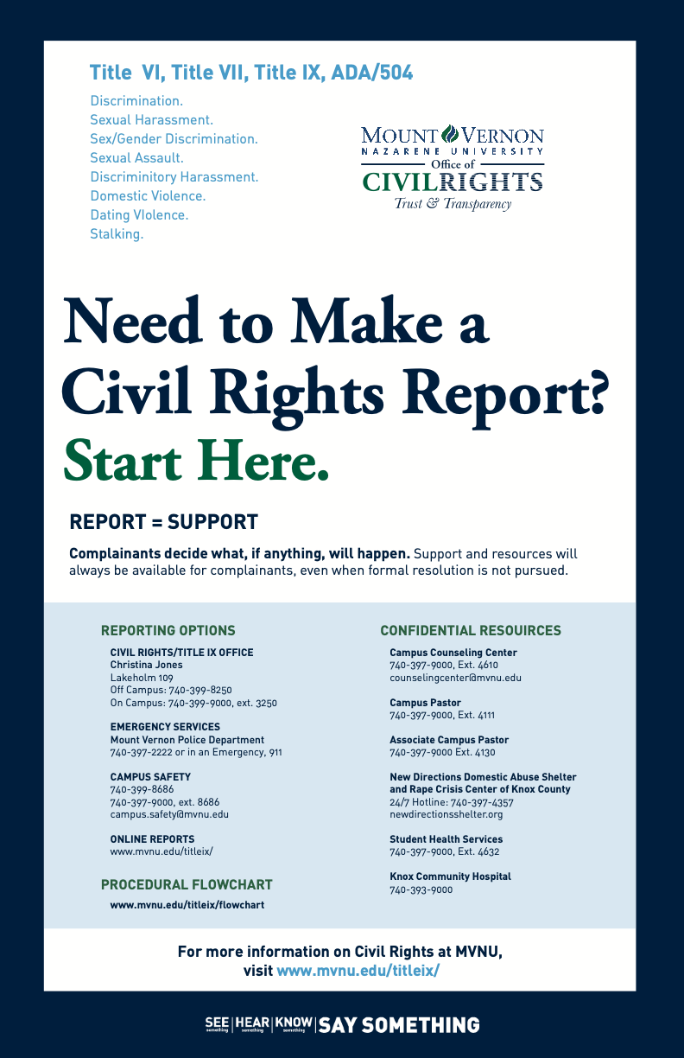
CAMPUS POSTER
STOP
  Stop the discrimination or harassment
PREVENT
  Prevent the reoccurrence
REMEDY
  Remedy the effect

Slide 12

Civil Rights Policy
Discrimination, Harassment, Sexual Misconduct
Title VI, Title VII, Title IX
Applies to all University students and employees
The Civil Rights Office is a policy driven entity and is designed to ensure that all its community members are free from discrimination and harassment as required by law and the University policies. The Policy prohibits specific forms of behavior, which the Policy collectively refers to as “Prohibited Conduct.”
This policy applies to all forms of Prohibited Conduct that:
  Occur on campus;
  Occur in any MVNU education or employment activities and programs; or
  Have continuing adverse effects on campus, on any member of the MVNU community, or in the context of any MVNU education or employment activities and programs, regardless of where the conduct occurred.
See the PURPOSE AND STATEMENT OF POLICY (p 7)

Slide 13
There are three tracks that may be pursued if a formal complaint is lodged with the Civil Rights Office.
Informal Resolution Process
Investigator Resolution Process
Hearing Resolution Process

Slide 14


SUPPORTIVE MEASURES BUILDING CULTURE
Regardless of when, where or with whom the conduct occurred, the University will offer resources and assistance to any individual who has been affected by Prohibited Conduct.
Non-disciplinary, non-punitive individualized services offered to both the complainant and respondent as appropriate, reasonably available, and without fee or charge.
Pay attention to culture, and shut down conversations, jokes, actions, or media that you wouldn't want directed at you or a loved one.
Step into situations that seem like they might be getting out of hand. BE A GOOD BYSTANDER, i.e., a Good Samaritan - a Good Neighbor
Build trust and bonds within our community ​
Encourage healthy social media habits
Tie this respect culture into our faith discussions

Slide 15

For the complete policies, go to www.mvnu.edu/titleix

