Slide 1



Athletics Department Training on Civil Rights & Anti-Hazing Policies
September 2022

Slide 2

Religious Expression
Who We Are and What We Believe
Being of Wesleyan heritage, and a ministry of the Church of the Nazarene, we strive to be a learning community where grace is foundational, truth is pursued, and holiness is a way of life. Furthermore, we attempt to make all policies and decisions within the doctrinal and moral convictions of the Church of the Nazarene as articulated within the Manual of the Church of the Nazarene (e.g., Articles of Faith, Covenant of Christian Conduct including the Statement on Human Sexuality and Marriage, Covenant of Christian Character, and the agreed upon Statement on Discrimination, 915). We also strive to provide a learning and living environment that promotes safety, transparency, personal integrity, civility, mutual respect and freedom from unlawful discrimination.
This integration of faith and learning is recognized by the United States and Ohio Constitutions and many state and federal laws. Therefore, it is a recognized right of religious educational institutions such as MVNU to incorporate religious beliefs into all aspects of university life and maintain faith-based standards of behavior which all community members voluntarily agree to follow.
MVNU seeks to recruit students of the Christian faith and to create an institutional environment conducive to their growth in Christ; however, we do not require that students be confessing Christians. We welcome and value students of every background and faith. As a Christian community, we expect that all of our students will respect the nature of our community, learn about our traditions and participate in our community practices. MVNU affirms that a Christian liberal arts education includes an understanding of and appreciation of the differences in faith, living, and practice.

Slide 3

Notice of Non-Discrimination
Mount Vernon Nazarene University is committed to fostering a non-discriminatory campus environment in which community members can learn and work. MVNU prohibits discrimination on the basis of race, sex, age, color, national origin, disability, marital status, or military service in the operation of all University programs, activities, and services. As a faith-based institution, the University is exempted from certain laws and regulations concerning discrimination. The University maintains the right, with regard to its lifestyle covenant, employment, and other matters, to uphold and apply its Christian beliefs related to, among other issues, marriage, sex (gender), gender identity, sexual orientation, and sexual activity to the fullest extent permitted by law. Thus, MVNU attempts to make all policies and decisions within the doctrinal and moral convictions of the Church of the Nazarene (e.g., Articles of Faith, Covenant of Christian Conduct including the Statement on Human Sexuality and Marriage, Covenant of Christian Character, and the Statement on Discrimination, 915).

Slide 4
2 Civil Rights Policies
Discrimination, Harassment, Sexual Misconduct
Resolving Complaints under ADA/Section 504
Find these at www.mvnu.edu/titleix

Slide 5

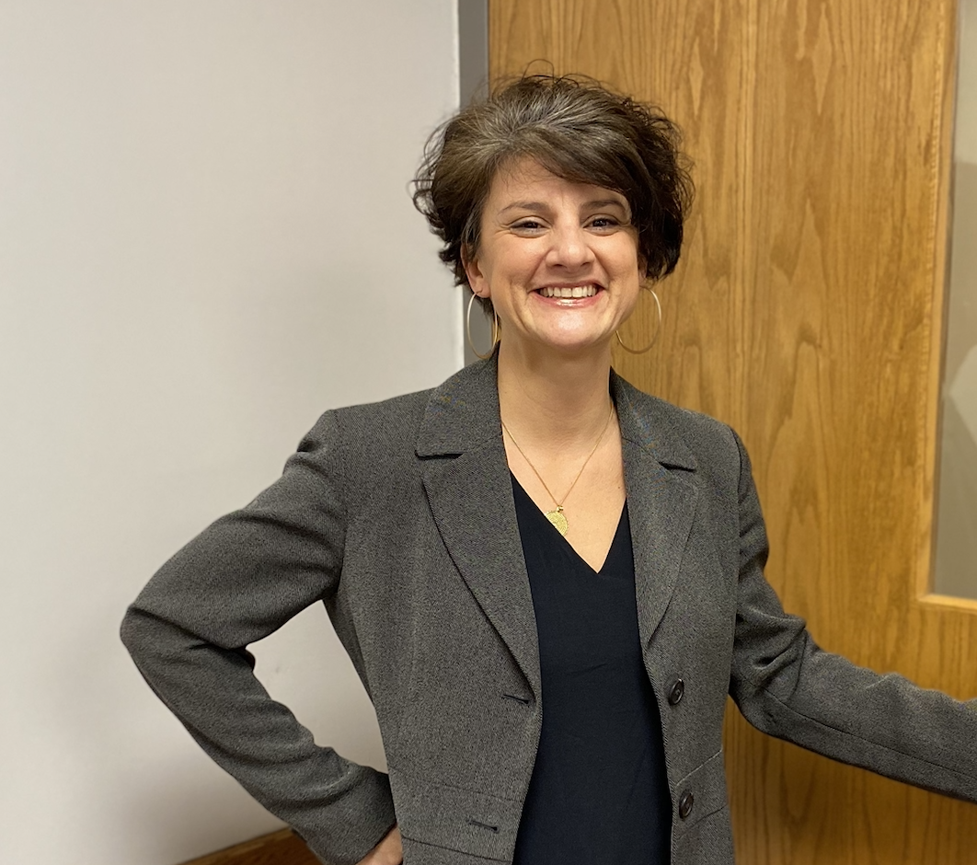
Civil Rights Office
Civil Rights Director
Christina Jones, J.D.
Lakeholm 109

Slide 6

MVNU is committed to fostering a climate free from discrimination and harassment, through clear and effective policies, a coordinated education and prevention program, and prompt and equitable procedures for resolution of reports of conduct prohibited under this policy. The University encourages all members of its community to participate in the process of creating a safe, welcoming and respectful environment on campus.
Title VI, 42 U.S.C. § 2000d et seq., was enacted as part of the landmark Civil Rights Act of 1964. It prohibits discrimination on the basis of race, color, and national origin in programs and activities receiving federal financial assistance.
Title VII, 42 U.S.C. § 2000e et seq., of the Civil Rights Act of 1964 helps protect individuals from discrimination in the workplace. It prohibits employment discrimination based upon race, color, national origin, sex and religion. Title VII also protects against harassment, which can be any physical or vocal conduct that creates an intimidating, hostile or offensive work environment. Conduct can be harassment if it interferes with a person's work performance.
Title IX, 20 U.S.C. §1681 et seq., of the Title IX of the Education Amendments of 1972 protects people from discrimination based on sex in education programs or activities that receive federal financial assistance.
ADA (The Americans with Disabilities Act of 1990), 42 U.S.C. §12101 and the Rehabilitation Act of 1973, Section 504 is a civil rights law that prohibits discrimination against people with disabilities in programs that receive financial assistance

Slide 7

Scope of Policy
The University’s Civil Rights policy applies to all students, faculty, staff, groups, members of the Board of Trustees, consultants, vendors, volunteers, others engaged in business with the University, guests and visitors. Every individual is responsible for acting in accordance with this policy and other MVNU policies and procedures. Any individual can be a reporting party or complainant.

Slide 8


CAMPUS POSTER
STOP
  Stop the discrimination or harassment
PREVENT
  Prevent the reoccurrence
REMEDY
  Remedy the effect

Slide 9
Civil Rights Policy
Discrimination, Harassment, Sexual Misconduct
Title VI, Title VII, Title IX
Applies to all University students and employees
The Civil Rights Office is a policy driven entity and is designed to ensure that all its community members are free from discrimination and harassment as required by law and the University policies. The Policy prohibits specific forms of behavior, which the Policy collectively refers to as “Prohibited Conduct.”
This policy applies to all forms of Prohibited Conduct that:
  Occur on campus;
  Occur in any MVNU education or employment activities and programs; or
  Have continuing adverse effects on campus, on any member of the MVNU community, or in the context of any MVNU education or employment activities and programs, regardless of where the conduct occurred.
Let’s take a look at PROHIBITED CONDUCT under the policy

Slide 10


NNU Athletes
Church of the Nazarene’s Manual
Statement on Discrimination
https://twitter.com/NNUSports/status/1269329663588851712?s=20&t=Lgvj7lZLY207G91VkvpM9Q

Slide 11

Title VI – Racial Discrimination
At MVNU, we believe that God is the Creator of all people. As we are made in His image, we believe that embracing and celebrating diversity brings us all closer together. As a ministry of the Church of the Nazarene we renounce any form of racial and ethnic indifference, exclusion, subjugation, or oppression as a grave sin against God and our fellow human beings (Manual, 915). Our campus community benefits from the diversity of students, staff, and faculty. We are a community of individuals who seek to learn from, and about, one another. Diversity is expressed through racial, ethnic, age, ability, geographic, gender, cultural, and socioeconomic differences among the campus community. To such ends, MVNU will not tolerate violence, aggression or discrimination against members of its community on the basis of one’s race, skin color, or national origin.

Slide 12

What Is Discriminatory Harassment?
Prohibited Conduct
Discriminatory harassment can take many forms. It may be, but is not limited to: words, signs, jokes, pranks, intimidation, physical contact, or violence. It also may include harassment that is sexual in nature or directed at the gender of another (as in sexual harassment).
Is intended to insult or stigmatize an individual or an identifiable group?
Is it addressed directly to or at (though not necessarily in the presence of) the individual or individuals whom it insults or stigmatizes
Does it make use of words or nonverbal symbols that convey hatred or contempt for human beings on the basis of a protected characteristic?
Harassment may also be constituted by nonverbal acts that would also be punishable as, for example, vandalism, physical assault, or destruction of property. Other examples of harassment include epithets or "jokes" referring to an individual's group-based attributes; placement of offensive written or visual material on another's work area; offensive messages sent through email; and undesired physical contact, physical violence, or threat of same.
Do NOT create a HOSTILE environment!

Slide 13


What Do I Report?
Prohibited
Conduct
Criminal Offenses
  Criminal homicide, murder, manslaughter, non-negligent manslaughter, sexual assault, rape, fondling, incest, statutory rape, robbery, aggravated assault, burglary, motor vehicle theft, arson
Hate Crimes
  Race, religion, sexual orientation, gender, gender identity, ethnicity, national origin, disability
VAWA (Violence Against Women Reauthorization Act) Offenses
  Dating violence, domestic violence, stalking
Arrests & Referrals for Disciplinary Action
  Weapons, drug abuse, liquor law violations
Let’s take a look at more PROHIBITED CONDUCT under the policy.

Slide 14

Title IX – Sexual Harassment
    Quid Pro Quo
    Unwelcome Conduct
    Sexual Assault
    Dating Violence
    Domestic Violence
    Stalking
For reported behavior to qualify as Prohibited Conduct under the Title IX- Sexual Harassment it must meet all of the following threshold requirements:
  The conduct must have occurred against a person in the United States.
  The conduct must have occurred within the University’s education program or activity. For purposes of this provision, this means that the conduct must have occurred either (a) in a location, event, or circumstances over which MVNU exercised substantial control over both the respondent and the context in which the sexual harassment occurs or (b) in relation to a building owned or controlled by a student organization that is officially recognized by the MVNU.
  The complainant must be participating in or attempting to participate in the education program or activity of the University at the time the formal complaint is filed.

Slide 15
Conduct that does not meet these threshold requirements is subject to a Title IX Dismissal but may still be resolved as a Non-Title IX Sexual Misconduct.
Non-Title IX Sexual Assault
Sexual and Gender-Based Harassment
Sexual Exploitation
Non-Title IX Domestic Violence
Non-Title IX Dating Violence
Non-Title IX Stalking

Slide 16

Consent Defined
Must be informed, knowing and voluntary – freely given through clear words or action​
Cannot use force, threats, intimidating behavior, or coercion (unreasonable/persistent pressure).​
It cannot be given by someone known to be – or who should be known to be mentally or physically incapacitated.​
​
Consent requires the following conditions: ​
​
1. All parties are fully conscious.​
2. All parties are equally free to act.​
3. All parties have positively and clearly communicated their intent.

Slide 17



ADA / Section 504
While the University prohibits discrimination and harassment on the basis of disability, it is covered in the Civil Rights Policy Resolving Complaints under the Disabilities Act and the Rehabilitation Act of 1973.
STUDENTS:
Further information is available on MVNU’s Accessibility Student Policy webpage.
EMPLOYEES:
Appropriate handbooks.
Grievance Procedures are found at www.mvnu.edu/titleix.

Slide 18
MANDATED REPORTER
Previously referred to as responsible employees.
All University employees, student employees, and affiliated individuals are required to disclose to the Civil Rights Office any report of harassment or discrimination of which they are aware to ensure the University is able to provide a prompt, thorough, and supportive response.
Confidential resources are exempt from this requirement.
Mandated reports do not require that complainants take any specific course of action, or any action at all, with regard to any process under this Policy.
If YOU are a student leader or work at MVNU you are required to report an incident as soon as you know about it and as much as you know.
REPORT = SUPPORT

Slide 19

What a Mandated Reporter Must Say Responding to a Disclosure
What a Mandated Reporter Must Tell Someone Sharing information about a possible Prohibited Conduct
Inform reporting party of:
  Their obligation to report the information to the Civil Rights Director
They may inform them of:
  Where they can report confidentially
  Counseling and other support services
  The right to file a complaint
  The right to report the crime to campus or local law enforcement
Clarify role as a Mandated Reporter.
Remind them that you must report to the Civil Rights Director but talking to the CRD is optional.
The CRD will keep the disclosure private.
Do NOT investigate! Do NOT mediate!
Listen. Support. Refer. Measures. Document.
Notes:
Your RD is a need to know employee, must keep them in the loop, but otherwise you are responsible to keep the privacy of the person who discloses to you. Others who “need to know” will be determined in conjunction with student life and the Title IX Office.

Slide 20

Confidential Resources
On Campus
Campus Counseling Center
Campus Pastor and Associate Pastor
Student Health Services
Off Campus
New Directions Domestic Abuse & Rape Crisis Center
Knox County Victim’s Assistance
National Domestic Violence Hotline
Ohio Sexual Violence Domestic Violence Hotline
Ohio Hispanic Coalition Domestic Violence Hotline
More Resources at mvnu.edu./titleix

Slide 21



How Do I Report? Writing an Incident Report
Civil Rights Director / TIX Coordinator / 504 Coordinator
  Lakeholm 109
  Off Campus: 740-399-8250 / On Campus: 740-399-9000, ext. 3250
  www.mvnu.edu/titleix
Campus Safety (24-hour availability)
  On Campus: 740-399-8686
  Off Campus: 740-399-9000, ext. 8686
  campus.safety@mvnu.edu
Any Non-Confidential University employee
Online Incident Report form at www.mnvu.edu/titleix
Use the Incident Report Form online @ www.mvnu.edu/titleix
Fill out the rest of the form to the best of your ability. As a mandated reporter you cannot report anonymously.
Be clear. Use first/last names. Avoid pronouns.
If you don’t know the exact date of the incident, indicate that in the narrative.
Report versus Formal Complaint

Slide 22
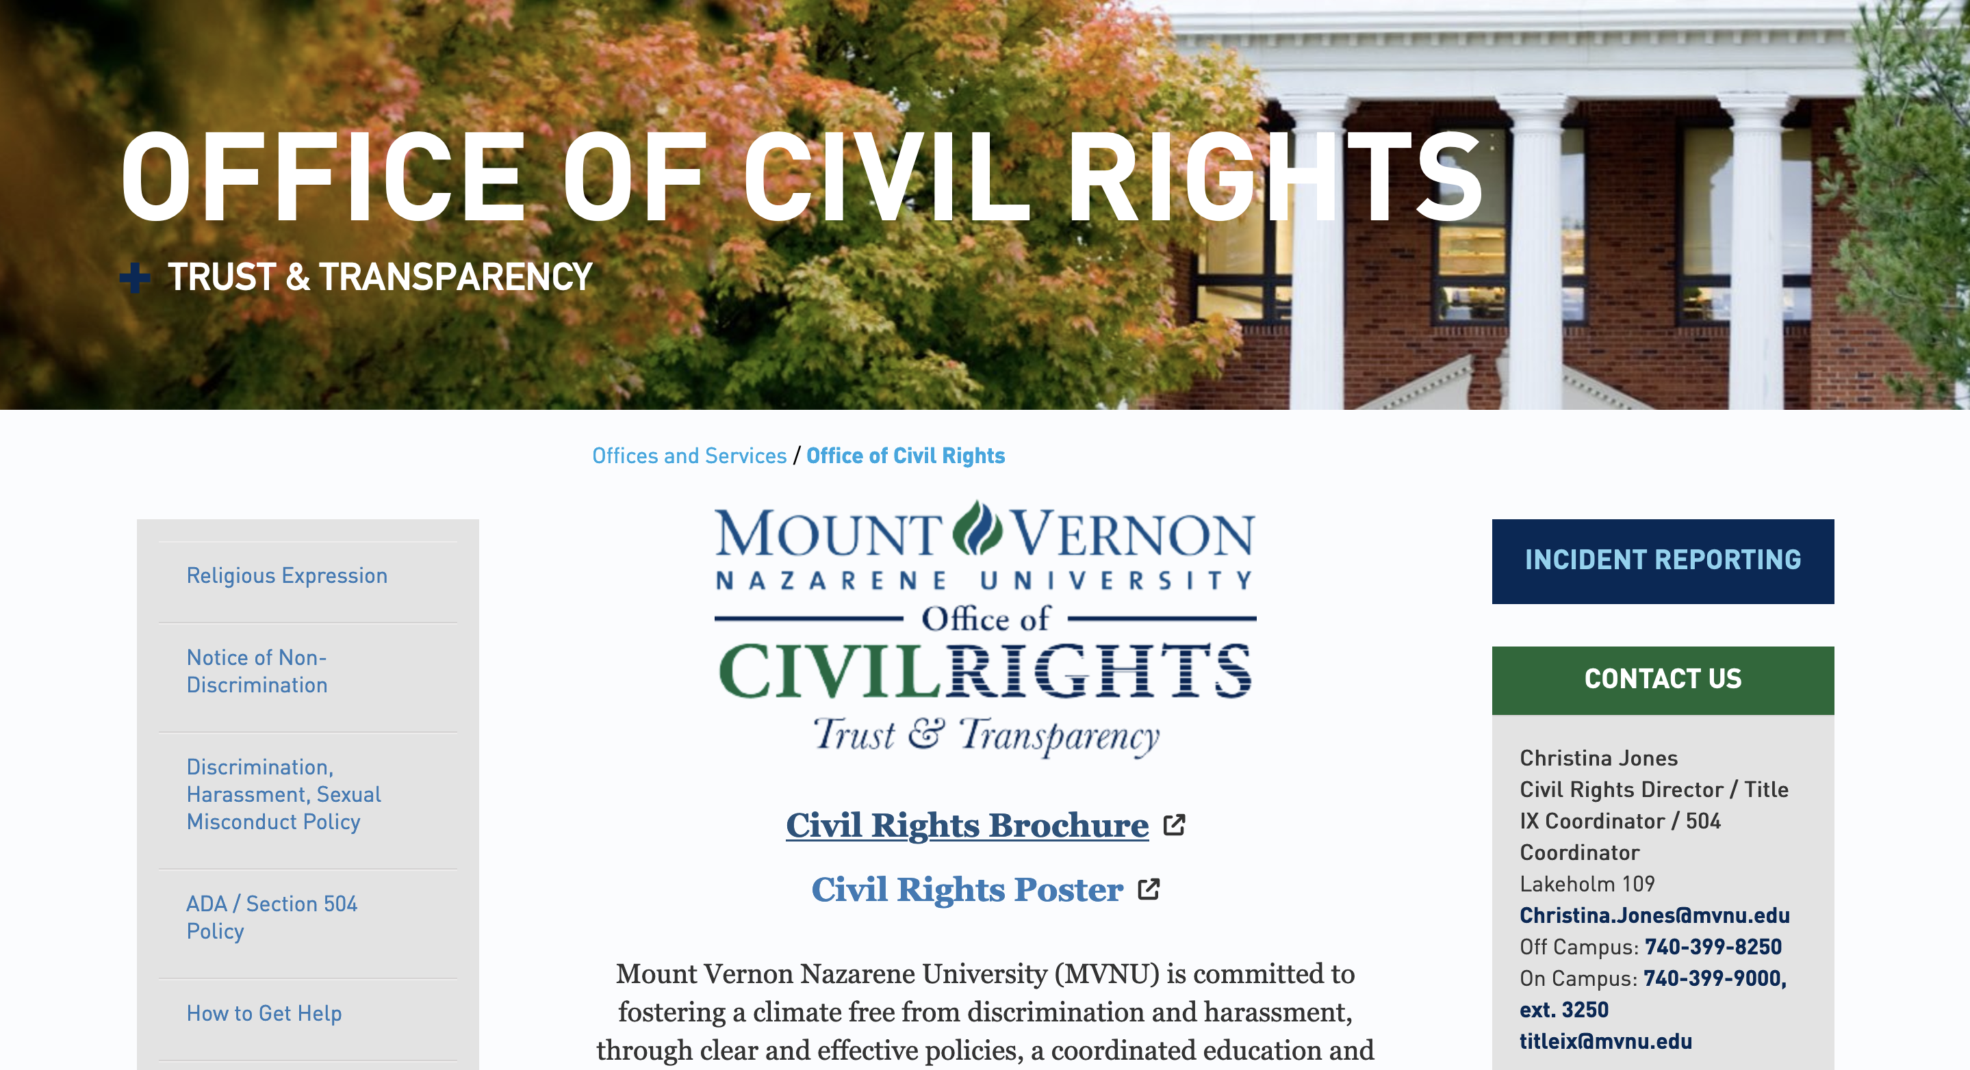

Civil Rights
Webpage

Slide 23
There are three tracks that may be pursued if a formal complaint is lodged with the Civil Rights Office.
Informal Resolution Process
Investigator Resolution Process
Hearing Resolution Process

Slide 24


SUPPORTIVE MEASURES BUILDING CULTURE
Regardless of when, where or with whom the conduct occurred, the University will offer resources and assistance to any individual who has been affected by Prohibited Conduct.
Non-disciplinary, non-punitive individualized services offered to both the complainant and respondent as appropriate, reasonably available, and without fee or charge.
Pay attention to culture, and shut down conversations, jokes, actions, or media that you wouldn't want directed at you or a loved one.
Step into situations that seem like they might be getting out of hand. BE A GOOD BYSTANDER, i.e., a Good Samaritan - a Good Neighbor
Build trust and bonds within our community ​
Encourage healthy social media habits
Tie this respect culture into our faith discussions

Slide 25

Scripture supports our mission
“You, my brothers and sisters, were called to be free. But do not use your freedom to indulge the flesh; rather, serve one another humbly in love. For the entire law is fulfilled in keeping this one command: “Love your neighbor as yourself.”
Gal. 5:13-14 (NIV)

Slide 26

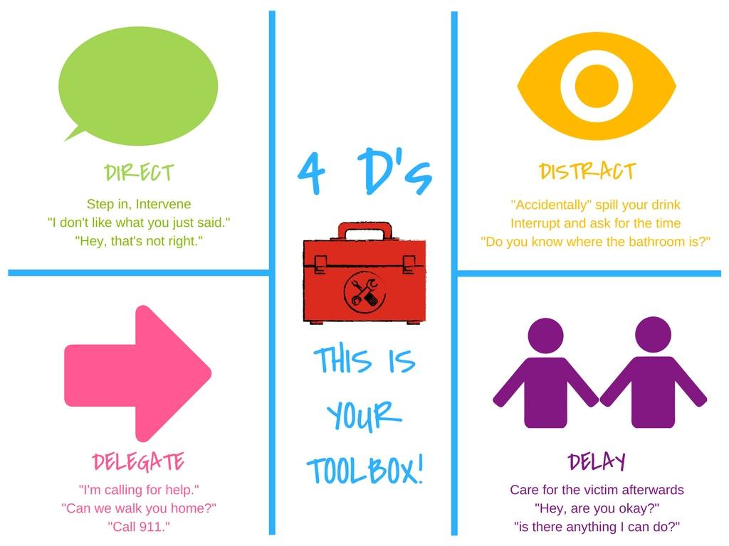

Bystander Intervention Recognizing Trauma
Be a part of the SOLUTION
  Anxiety/Depression​
  Low self-esteem​
  Reinforcements of stereotypes​
  Flashbacks​
  Disrupted sleep, loss of concentration​
  Suicidal thoughts/self-harming ​
  Breakdown in trust
Dizziness​
Dilated pupils​
Dry mouth​
Muscle tension​
Hyperventilation​
Rapid Speech​
Anxiety​
Floods of Emotion​
Unfocused eyes​
Disassociation​
Low energy​
Non-responsive

Slide 27

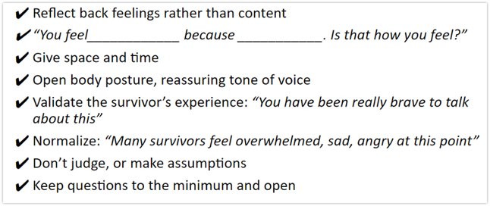
How do you help?
Be present, active listening, be patient​
Validate their feelings​
Offer resources​
  Counseling/Campus pastors, Title IX office support (adjust class schedules, police report, no-contact orders, room re-assignments, etc)

Slide 28

Check out the MVNU Civil Rights Brochure

Slide 29
For the complete policies, go to www.mvnu.edu/titleix
Amnesty
Reporting Options
Prohibited Conduct
Consent, Force, Coercion, Incapacitation
Relationships
Complaint Resolution Processes & Flowchart

Slide 30


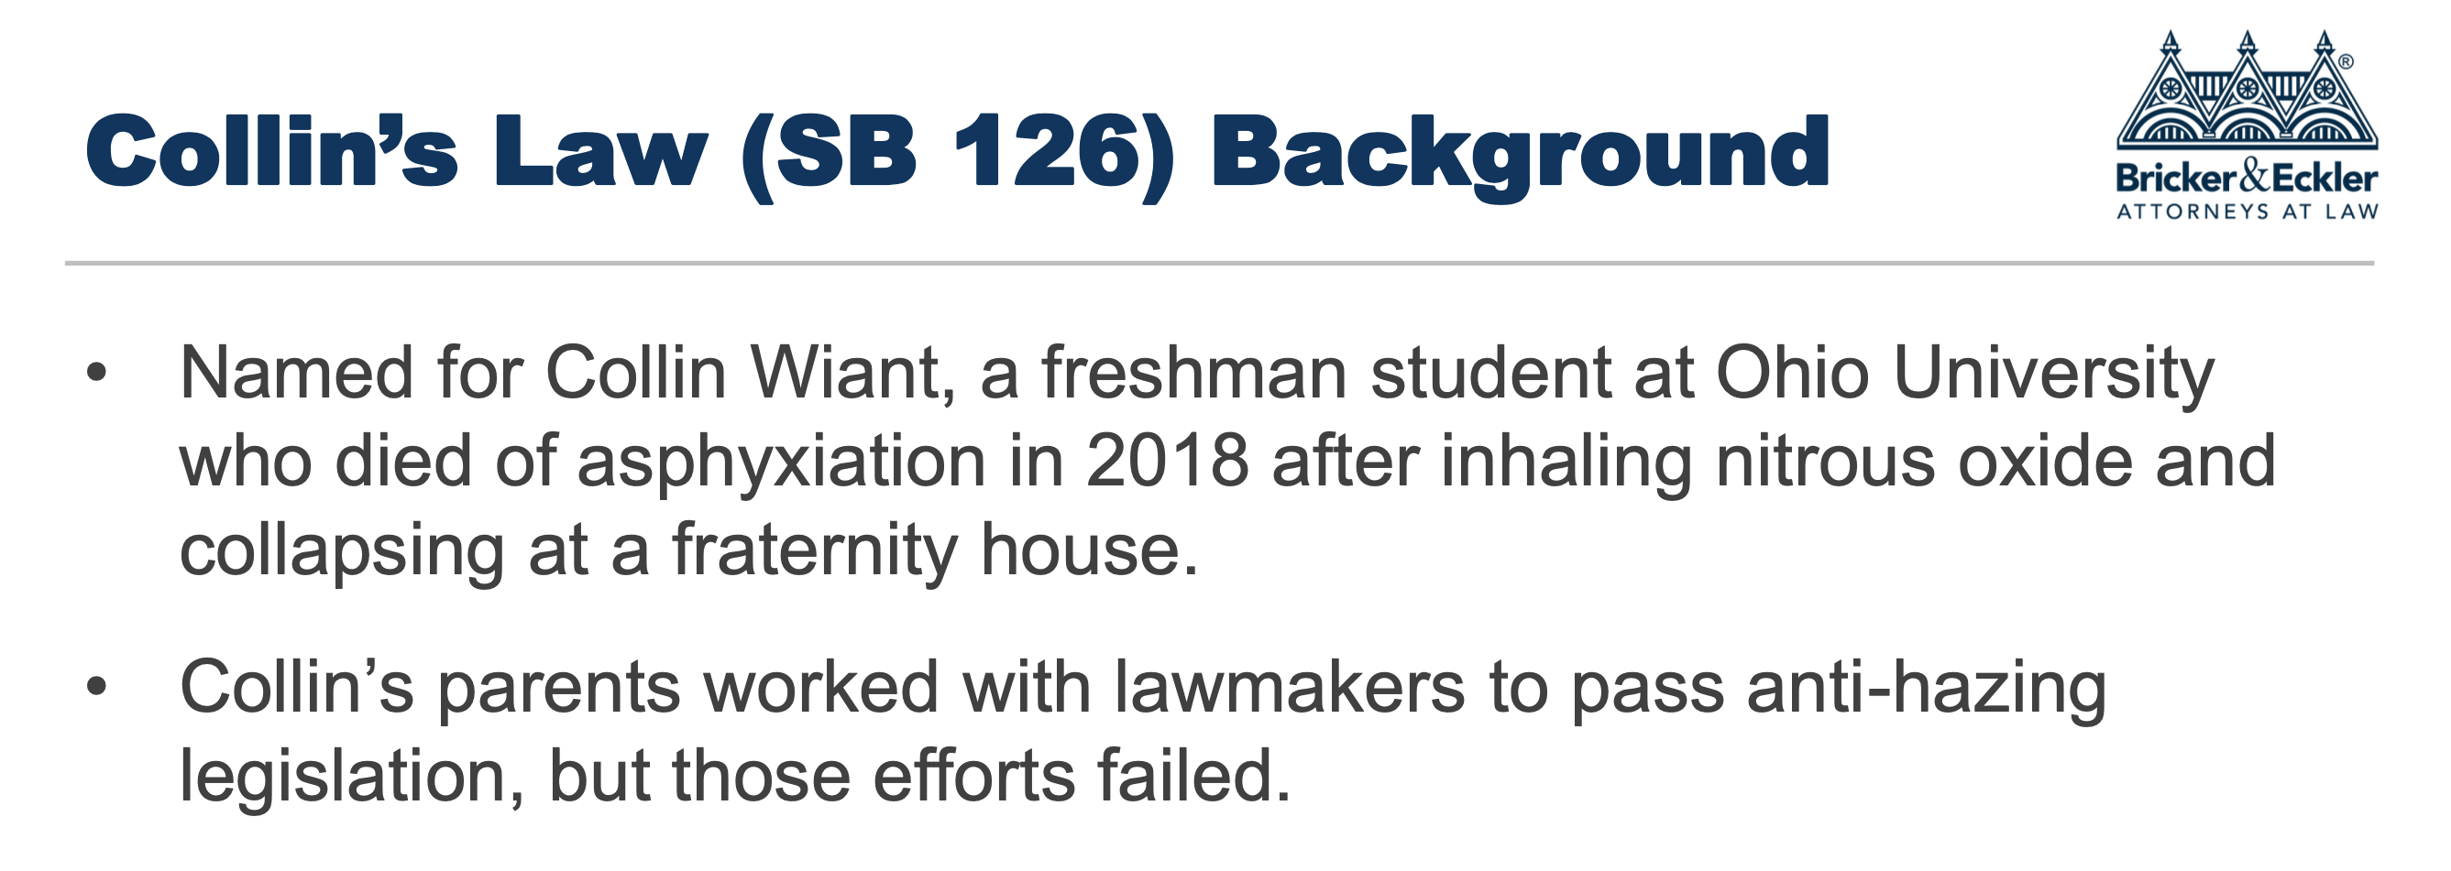
ANTI-HAZING POLICY
Notes:
Here’s an overview of how our discipline process works. [Click] (I’m loosing steam…)
Read. [Click]
Read [Click]
Read [Click]
Read [Click]

Slide 31
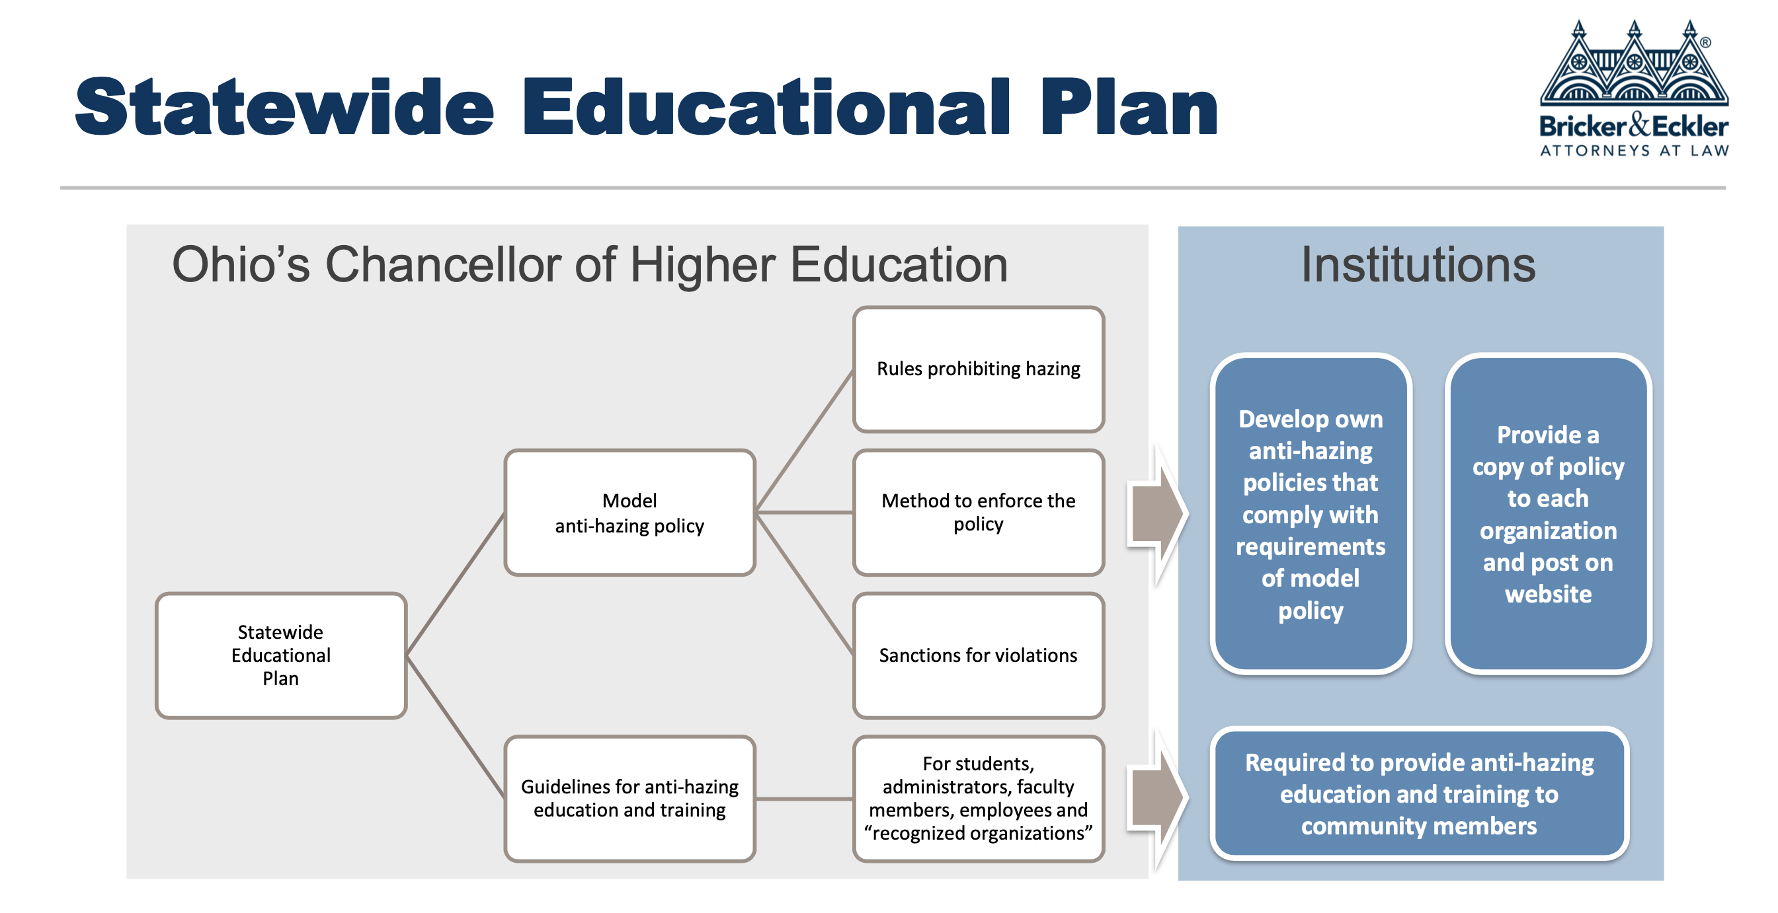

Slide 32
ANTI-HAZING POLICY
WHAT IS HAZING?
The Ohio Revised Code, Section 2903.31 defines hazing as: "doing any act or coercing another, including the victim, to do any act of initiation into any student or other organization or any act to continue or reinstate membership in or affiliation with any student or other organization that causes or creates a substantial risk of causing mental or physical harm to any person, including coercing another to consume alcohol or a drug of abuse, as defined in section 3719.011 of the Revised Code.
Notes:
Here’s an overview of how our discipline process works. [Click] (I’m loosing steam…)
Read. [Click]
Read [Click]
Read [Click]
Read [Click]

Slide 33

PENALTIES
RECKLESS PARTICIPATION
Prohibits administrators, employees, faculty members, teachers, consultants, alumni or volunteers from recklessly permitting the hazing of any person associated with an institutional organization.
Old Penalty | Collin’s Law penalty
Second degree misdemeanor | Fourth degree misdemeanor
30 days in jail and/or fine of $250 | 90 days in jail and/or fine of $750
NEW: COERCED CONSUMPTION
Prohibits hazing that involves “coerced consumption of alcohol or drugs of abuse resulting in serious physical harm to that person.”
Collin’s Law penalty
Third degree felony (for hazing participants and those who recklessly permitted)
Prison sentence and/or fine of $10,000

Slide 34
ANTI-HAZING POLICY
WHAT IS HAZING?
MVNU considers hazing to be any act which endangers the mental or physical health or safety of a student, or which destroys or removes public or private property for the purpose of initiation, admission into, or affiliation with, or as a condition for continued membership in a group or organization, whether the person subjecting to such behavior participates willingly or not.
Notes:
Here’s an overview of how our discipline process works. [Click] (I’m loosing steam…)
Read. [Click]
Read [Click]
Read [Click]
Read [Click]

Slide 35
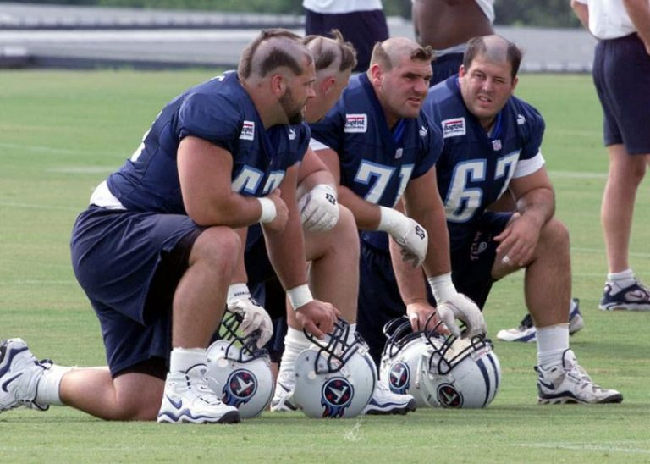
ANTI-HAZING POLICY
WHAT IS HAZING?
Hazing acts may be physical, mental, emotional or psychological, which subjects another, to anything which may abuse, mistreat, degrade, humiliate, discomfort, ridicule, harm, or intimidate.
Notes:
Here’s an overview of how our discipline process works. [Click] (I’m loosing steam…)
Read. [Click]
Read [Click]
Read [Click]
Read [Click]

Slide 36

ANTI-HAZING POLICY
EXAMPLES
running errands/menial tasks
mental and/or psychological abuse
public or private displays of humiliation
forced use of alcohol or drugs
line-ups
forced eating or drinking of items
being yelled at or cursed at by other members of the team or group
sleep deprivation
forced wearing of embarrassing clothing
*This list contains some examples but does not list all examples of hazing
Notes:
Here’s an overview of how our discipline process works. [Click] (I’m loosing steam…)
Read. [Click]
Read [Click]
Read [Click]
Read [Click]

Slide 37
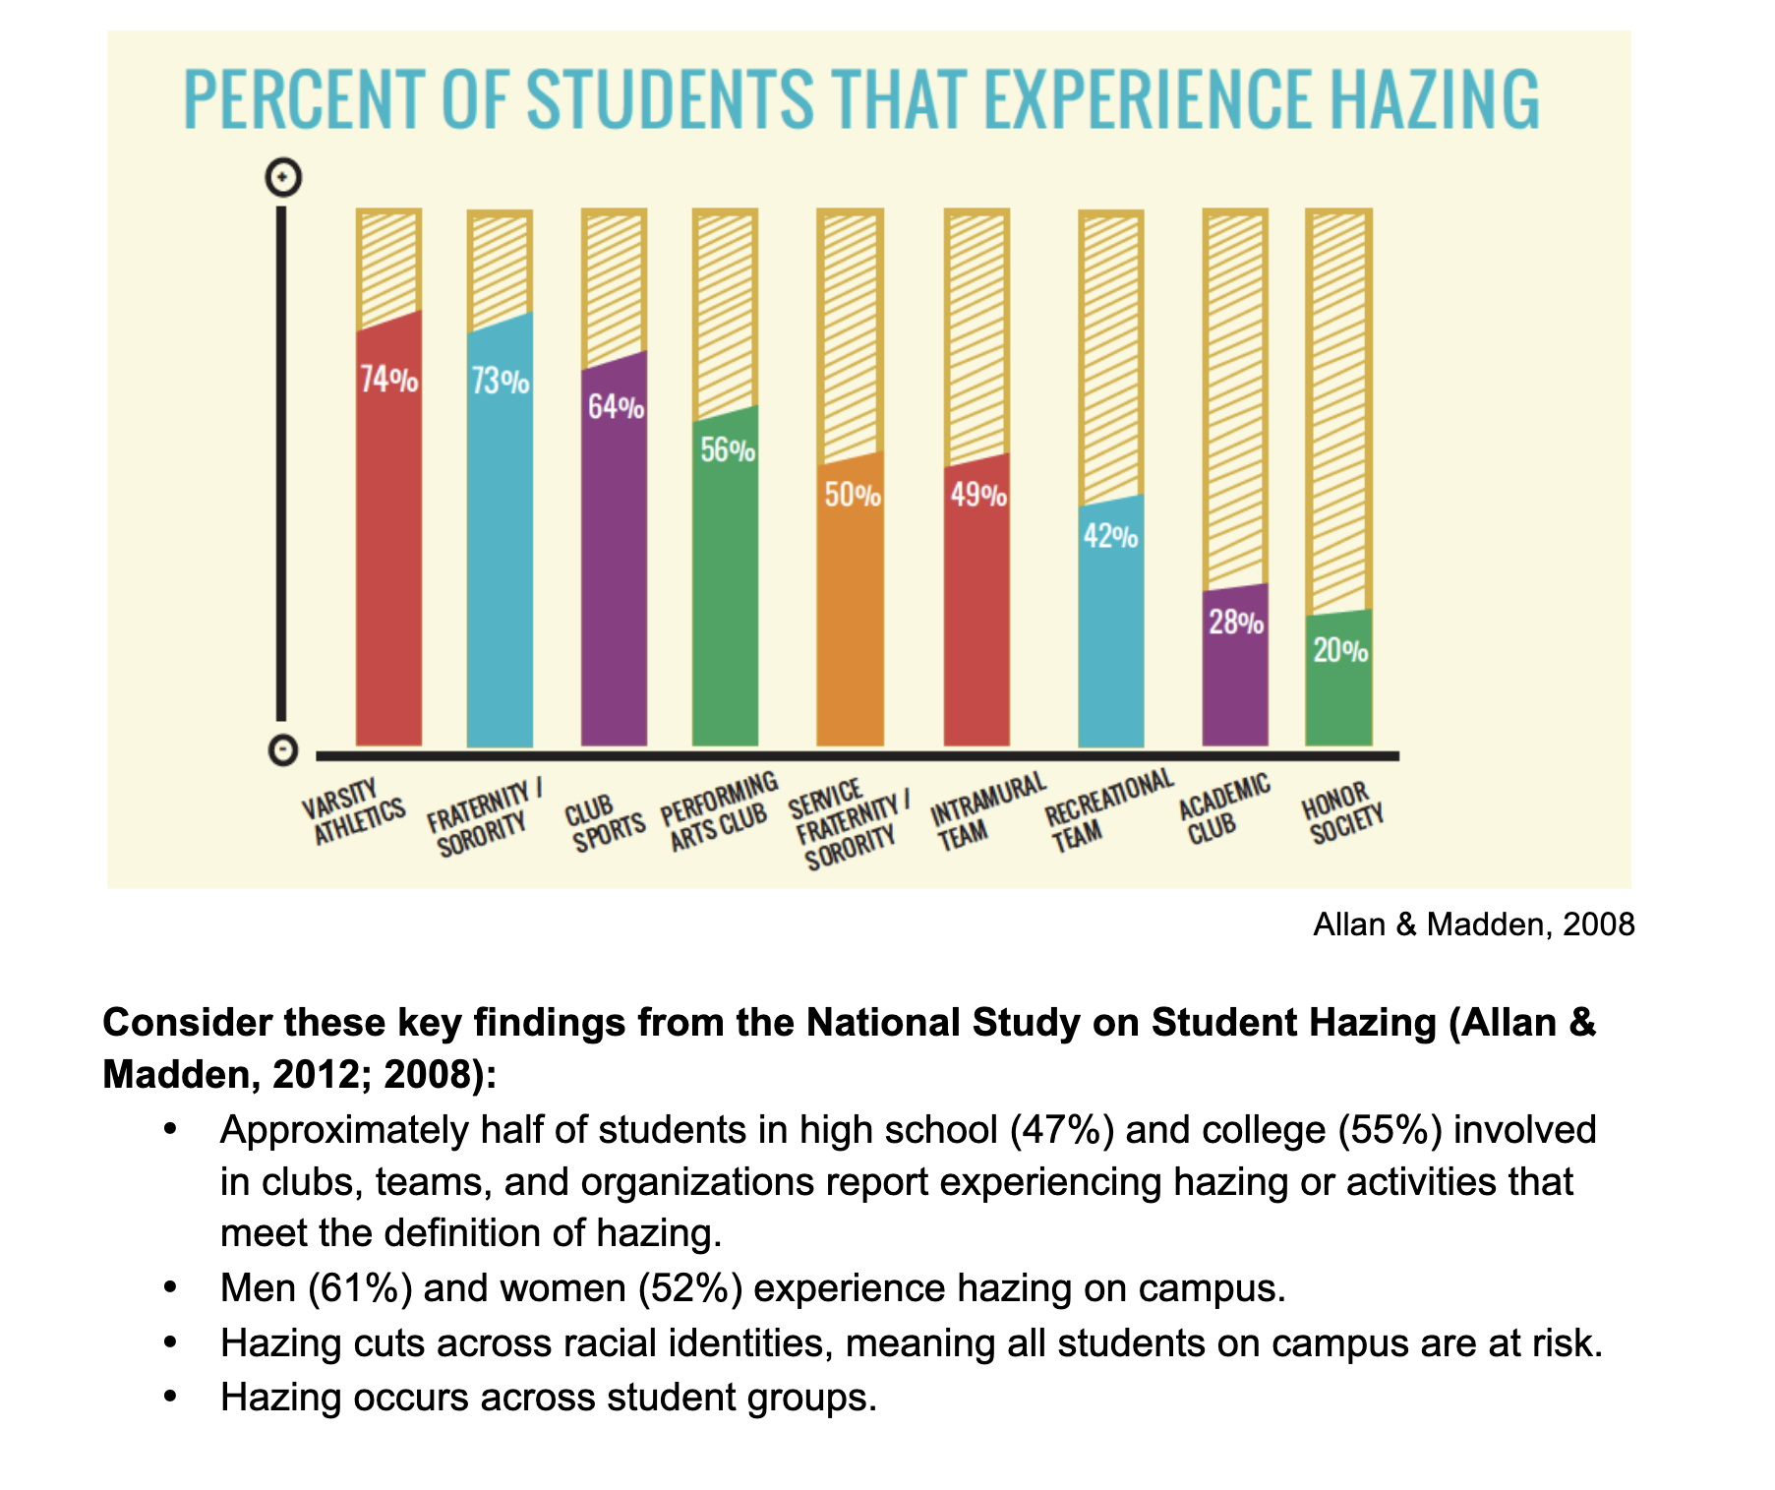

Slide 38
ANTI-HAZING POLICY
SCOPE OF THIS POLICY
This regulation applies to all members of the University community, including faculty, staff, students, volunteers, organizations, and groups, as well as visitors and other licensees and invitees regardless of if it occurs on or off campus.
Notes:
Here’s an overview of how our discipline process works. [Click] (I’m loosing steam…)
Read. [Click]
Read [Click]
Read [Click]
Read [Click]

Slide 39

ANTI-HAZING POLICY
Training/Education
Students must be offered at least 1 opportunity to complete the program during new student orientation
Attendance must be verified by the institution
If a student does not complete this educational programming, they must be prohibited from participating in a recognized organization until the programming is completed
Notes:
Here’s an overview of how our discipline process works. [Click] (I’m loosing steam…)
Read. [Click]
Read [Click]
Read [Click]
Read [Click]

Slide 40
REQUIRED REPORTING
Collin’s Law requires that any administrator, employee, faculty member, teacher, consultant, alumnus or volunteer of any organization immediately report hazing to a law enforcement agency in the county in which the victim of hazing resides or in which the hazing is occurring or has occurred.
Failure to report could constitute a criminal offense.
  It is important for campus community members to understand their obligations and how to report instances of hazing.
Anonymous reports do NOT satisfy the obligations under Collin’s Law
Notes:
Here’s an overview of how our discipline process works. [Click] (I’m loosing steam…)
Read. [Click]
Read [Click]
Read [Click]
Read [Click]

Slide 41

ANTI-HAZING POLICY
REPORTING
Individuals and/or Student Organizations should report instances of hazing through the Hazing Incident Report Form. Reports will be routed to the Student Life Office.
If a member of the University community is aware of immediate physical danger to a student or others, they must contact police at or dial 911.
Notes:
Here’s an overview of how our discipline process works. [Click] (I’m loosing steam…)
Read. [Click]
Read [Click]
Read [Click]
Read [Click]

Slide 42
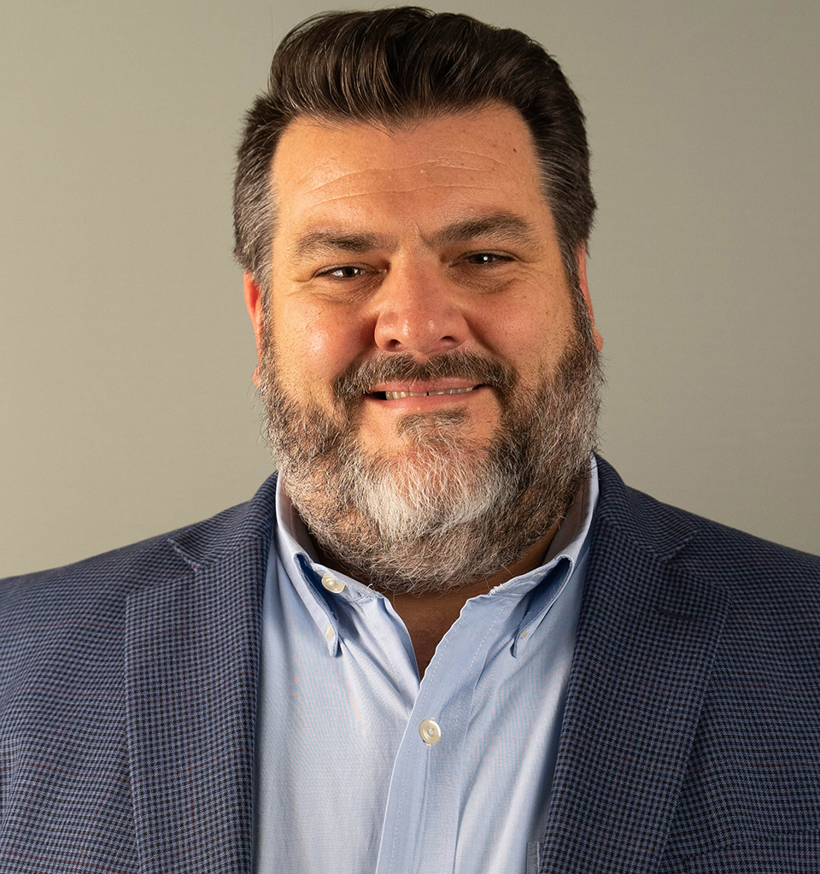
ANTI-HAZING POLICY
STUDENT REPORTING
• Student Life office 740-392-6868 ext. 4602, Matthew.spraker@mvnu.edu
• Campus Safety 740-399-8686
• Anonymous reports of hazing can be submitted online Hazing Reporting Form
• In the event of an emergency, please contact Campus Safety at 740-399-8686 or 911.
Notes:
Here’s an overview of how our discipline process works. [Click] (I’m loosing steam…)
Read. [Click]
Read [Click]
Read [Click]
Read [Click]

Slide 43

ANTI-HAZING POLICY
EMPLOYEE REPORTING
Immediately upon learning of potential hazing, any employee with a duty to report violations of this policy who received a complaint of hazing or who observes or learns of conduct that is reasonably believed to be in violation of this policy is required to report the alleged conduct to: Student Life office - 740-392-6868 , Matthew.spraker@mvnu.edu
A mandatory reporter who fails to make a timely report
may be subject to appropriate discipline.
Notes:
Here’s an overview of how our discipline process works. [Click] (I’m loosing steam…)
Read. [Click]
Read [Click]
Read [Click]
Read [Click]

Slide 44
ANTI-HAZING POLICY
EMPLOYEE REPORTING
Each of the following is considered a “mandatory reporter”:
(1) Any full or part-time employee of the University (including student employees and graduate assistants)
(2) Any volunteer acting in an official capacity who advises or coaches student
organizations and/or student groups and who have direct contact with students.
*Employees who are required by law to protect confidentiality are exempt from this requirement
Notes:
Here’s an overview of how our discipline process works. [Click] (I’m loosing steam…)
Read. [Click]
Read [Click]
Read [Click]
Read [Click]

Slide 45
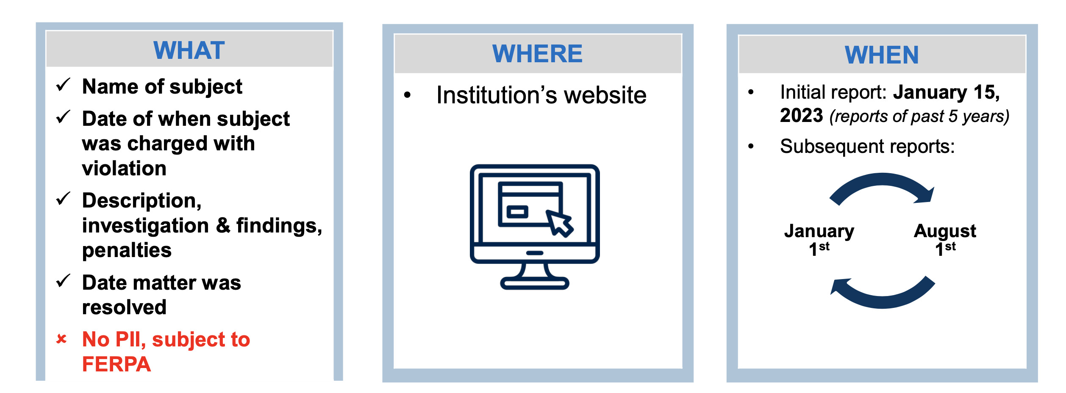
REPORTING VIOLATIONS
UNIVERSITY REPORTING
Starting next year (2022-23 academic school year), institutions will be required to maintain a report of all violations.
Notes:
Here’s an overview of how our discipline process works. [Click] (I’m loosing steam…)
Read. [Click]
Read [Click]
Read [Click]
Read [Click]

