Slide 1


ADJUDICATOR &
APPEAL OFFICERS
Training 2023

Slide 2


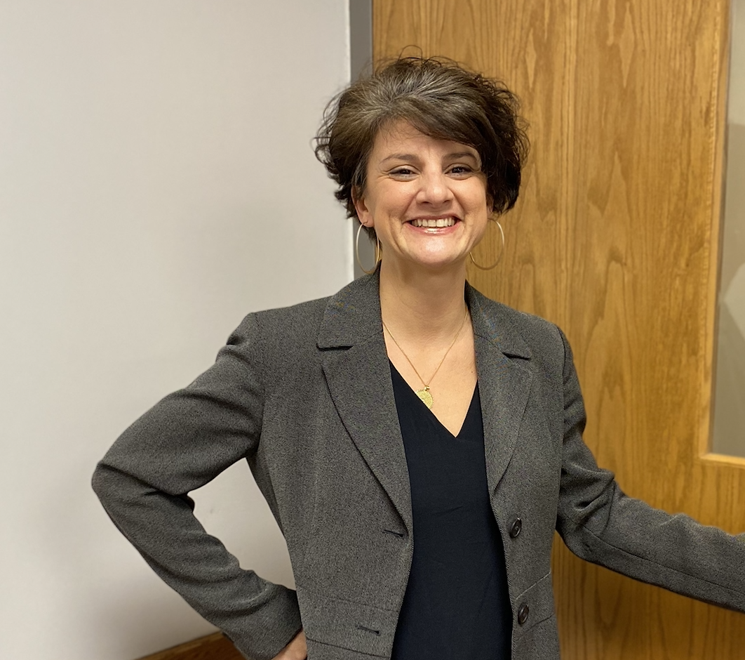

Civil Rights Director
Christina Jones, J.D.
Lakeholm 109
Katie Sherman, Deputy TIX Coordinator

Slide 3


Religious
Expression
Who We Are and What We Believe
Being of Wesleyan heritage, and a ministry of the Church of the Nazarene, we strive to be a learning community where grace is foundational, truth is pursued, and holiness is a way of life. Furthermore, we attempt to make all policies and decisions within the doctrinal and moral convictions of the Church of the Nazarene as articulated within the Manual of the Church of the Nazarene (e.g., Articles of Faith, Covenant of Christian Conduct including the Statement on Human Sexuality and Marriage, Covenant of Christian Character, and the agreed upon Statement on Discrimination, 915). We also strive to provide a learning and living environment that promotes safety, transparency, personal integrity, civility, mutual respect and freedom from unlawful discrimination.
This integration of faith and learning is recognized by the United States and Ohio Constitutions and many state and federal laws. Therefore, it is a recognized right of religious educational institutions such as MVNU to incorporate religious beliefs into all aspects of university life and maintain faith-based standards of behavior which all community members voluntarily agree to follow.
MVNU seeks to recruit students of the Christian faith and to create an institutional environment conducive to their growth in Christ; however, we do not require that students be confessing Christians. We welcome and value students of every background and faith. As a Christian community, we expect that all of our students will respect the nature of our community, learn about our traditions and participate in our community practices. MVNU affirms that a Christian liberal arts education includes an understanding of and appreciation of the differences in faith, living, and practice.
Be a Good Neighbor

Slide 4

Civil Rights Policies
Discrimination, Harassment, Sexual Misconduct
Pregnancy Accommodations and Related Conditions
Resolving Complaints under ADA/Section 504
Find these at www.mvnu.edu/titleix

Slide 5

Ethic of Care
Value: Equity
  “What we do for one, we do for the other.”
  Must give equal respect to all parties.
  Good decision makers are going to LOOK at the FACTS.
Value: Transparency
  “If they hear nothing, they’ll assume you’re doing nothing or actively working against them.”
  Give regular updates
  Use similar templates for communications
  Don’t withhold anything that is relevant.
Value: Integrity
  Personal integrity & integrity within the process
  Watch out for conflicts of interest or bias
  Don’t use or share information outside the process BUT all evidence should be “on the table” for all parties and advisors to see.

Slide 6

MVNU is committed to fostering a climate free from discrimination and harassment, through clear and effective policies, a coordinated education and prevention program, and prompt and equitable procedures for resolution of reports of conduct prohibited under this policy. The University encourages all members of its community to participate in the process of creating a safe, welcoming and respectful environment on campus.
Title VI, 42 U.S.C. § 2000d et seq., was enacted as part of the landmark Civil Rights Act of 1964. It prohibits discrimination on the basis of race, color, and national origin in programs and activities receiving federal financial assistance.
Title VII, 42 U.S.C. § 2000e et seq., of the Civil Rights Act of 1964 helps protect individuals from discrimination in the workplace. It prohibits employment discrimination based upon race, color, national origin, sex and religion. Title VII also protects against harassment, which can be any physical or vocal conduct that creates an intimidating, hostile or offensive work environment. Conduct can be harassment if it interferes with a person's work performance.
Title IX, 20 U.S.C. §1681 et seq., of the Title IX of the Education Amendments of 1972 protects people from discrimination based on sex in education programs or activities that receive federal financial assistance.
ADA (The Americans with Disabilities Act of 1990), 42 U.S.C. §12101 and the Rehabilitation Act of 1973, Section 504 is a civil rights law that prohibits discrimination against people with disabilities in programs that receive financial assistance

Slide 7





CAMPUS POSTER
STOP
  Stop the discrimination or harassment
PREVENT
  Prevent the reoccurrence
REMEDY
  Remedy the effect
Take a look at PROHIBITED CONDUCT under the policy.
What Do YOU Report?
Prohibited
Conduct

Slide 8

MANDATED REPORTER
Amnesty for Personal Use of Alcohol or Other Drugs
The University seeks to remove barriers to reporting. MVNU will offer any student who reports or experiences Prohibited Conduct limited immunity from being charged for policy violations related to the personal ingestion of alcohol or other drugs, provided that any such violations did not and do not place the health and safety of any person at risk. However, we may pursue educational or therapeutic remedies for those individuals, rather than punishment. MVNU desires to encourage its community members to offer help to others in need.
All University employees, student employees, and affiliated individuals are required to disclose to the Civil Rights Office any report of harassment or discrimination of which they are aware to ensure the University is able to provide a prompt, thorough, and supportive response.
Confidential resources are exempt from this requirement.
Reports do not require that complainants take any specific course of action, or any action at all.
If YOU are a student leader or work at MVNU you are required to report an incident as soon as you know about it and as much as you know.
REPORT = SUPPORT

Slide 9

Confidential Resources
Directly access numbers from “How to Get Help” tab on webpage
On Campus
Campus Counseling Center
Campus Pastor and Associate Pastor
Student Health Services
Off Campus
New Directions Domestic Abuse & Rape Crisis Center
Knox County Victim’s Assistance
National Domestic Violence Hotline
Ohio Sexual Violence Domestic Violence Hotline
Ohio Hispanic Coalition Domestic Violence Hotline
More Resources at mvnu.edu./titleix

Slide 10

SUPPORTIVE MEASURES
Regardless of when, where or with whom the conduct occurred, the University will offer resources and assistance to any individual who has been affected by Prohibited Conduct.
Non-disciplinary, non-punitive individualized services offered to both the complainant and respondent as appropriate, reasonably available, and without fee or charge.
Access to counseling and health services
Mutual “no-contact order”
Altering housing or work arrangements;
Providing campus escorts;
Providing transportation accommodations;
Offering adjustments to academic deadlines, course schedules, alternative course completion;
Limiting an individual’s or organization’s access to certain MVNU facilities or activities;
Voluntary leave of absence;
Increased security and monitoring of certain areas of the campus;
Providing academic support services, such as tutoring;
MVNU-imposed administrative leave or separation;
Other remedies that can reasonably be tailored to the involved individuals to achieve the goals of this policy.
NON-PUNITIVE SERVICES

Slide 11

Important Things to Know
How to report? ONLINE FORM OR IN PERSON
What to report? PROHIBITED CONDUCT
Who must report? EVERYONE
What are supportive measures? NON-PUNITIVE SERVICES
What are the processes? FORMAL / INFORMAL
What is consent? CLEAR, KNOWING, VOLUNTARY
What is Bystander Intervention? STAND UP & SPEAK UP

Slide 12

Terms
Roles
Prohibited Conduct

Slide 13
Terms
Civil Rights Director/ Title IX & 504
Coordinator
Investigators
Hearing Chair
Adjudicator
Appeal Officer
Advisor
Live Hearing
Investigator Decision
Supportive Measures
Witness
Title IX Dismissal
Restricted Access
Complainant
Respondent
Report
Complaint
Prohibited Conduct
Formal Resolution
Informal Resolution
Remedies
Preponderance of the Evidence

Slide 14



MVNU prohibits discrimination and harassment on the basis of disability.
It is covered in the Civil Rights Policy Resolving Complaints under the Disabilities Act and the Rehabilitation Act of 1973.
STUDENTS: Further information is available on MVNU’s Accessibility Student Policy webpage.
EMPLOYEES: Appropriate handbooks.
Grievance Procedures are found at www.mvnu.edu/titleix.
ADA / Section 504
Accommodations are provided under the law.

Slide 15
Resolving Complaints under ADA/Section 504
Grievance Procedure
Purpose and Scope
The University prohibits discrimination on the basis of disability. MVNU has adopted an internal grievance procedure for prompt and equitable resolution of complaints alleging any action prohibited by federal regulations implementing Section 504 of the Rehabilitation Act of 1973, as amended, and the Americans with Disabilities Act of 1990 (ADA).
Issues that are grievable include, but are not limited to, a denial of a requested accommodation, the inadequacy of an accommodation, the inaccessibility of a program or activity due to disability, or discrimination or harassment based on disability.

Slide 16
Resolving Complaints under ADA/Section 504: Employer / Visitor
How to File a Grievance
Submit to CRO in writing within 30 calendar days of the date upon which the grievant becomes aware of the alleged prohibited action. Complaints received later than 30 calendar days after complainant became aware of the alleged violation will be dismissed as untimely.
Grievance Procedure
Informal investigation by CRD
A written determination (no later than 30 days after submission) on the grievance and a description of the resolution, will be issued by the MVNU’s CRD or HRD (or designee).
CRD and/or HRD shall maintain records
grievant may request reconsideration of the resolution if they are dissatisfied with the resolution within 14 days:
  Faculty: VPAA (30 days to respond)
  Staff & Visitors: DHR (30 days to respond)

Slide 17
Resolving Complaints under ADA/Section 504:
Student
Grievance Procedure
Informal Pre-Grievance Meeting: the grievant is strongly encouraged to discuss their concerns in a pre-grievance meeting with the respondent(s) alleged to be directly responsible for the possible violation(s) in an effort to seek an informal resolution.
When a matter cannot be resolved informally, or if a student prefers to file a formal grievance, a written grievance must be submitted to the CRD.

Slide 18
Resolving Complaints under ADA/Section 504: Student
Grievance Procedure
A formal grievance must be filed within 30 calendar days of the date upon which the grievant(s) become(s) aware of the alleged prohibited action(s).
Upon receipt of a grievance, the CRD will send the respondent(s) a copy of the grievance and ask the respondent(s) to prepare a response within 14 calendar days
CRD will conduct a prompt investigation & maintain the records
CRD will issue a written decision within 30 days of receiving grievance
Appeal must be filed within 14 days and VPSL will provide a written appeal decision within 30 days. This decision is final.
See alternatives to conflict circumstances.

Slide 19

Terms: Preponderance of the Evidence
(Section II. Glossary & Definitions)
“A preponderance of the evidence means that the information or evidence provided is more likely than not to be true. When evaluating the information and evidence, the decision-maker(s) will first evaluate the quality. The decision-maker(s) will consider all of the information and evidence regardless of its origin. Any information or evidence the decision-maker(s) find to be of high quality should be given more weight than any information or evidence the decision maker(s) find to be of low quality. Quality may or may not be identical with quantity, and sheer quantity alone should not be the basis for a finding of responsibility. The testimony of a single party or witness or a single piece of information or evidence may be sufficient to establish a fact.”
Definition continued on next slide

Slide 20
Terms: Preponderance of the Evidence
(Section II. Glossary & Definitions)
“Decisions that require the use of an evidentiary standard (determinations of responsibility, process appeals, challenges to Title IX dismissal, and findings of fact) will be made after the decision maker(s) assess the quality of the information or evidence and unanimously determine that the decision is justified. That is, the decision-maker(s) should find that there is sufficient evidence that is relevant, probable, and persuasive to convince them that a particular assertion is more likely than not and that the evidence supporting such an assertion outweighs any evidence to the contrary.”
Definition continued from previous slide

Slide 21

Roles in the Formal Track
Title IX Hearing
Resolution Process
Civil Rights Director/TIX Coordinator
Investigators
Witness
Hearing Chair
Advisor (assigned if not chosen)
Adjudicator = Advisory Role
Appeal Officer
Non-Title IX Investigator Resolution Process
Civil Rights Director/TIX Coordinator
Investigators
Witness
Advisor (party chooses, not assigned)
Adjudicator
Appeal Officer
Race,
Disability, Sexual Misconduct

Slide 22
Roles in the Formal Track
Trained Internal Investigators
Katie Sherman – TIX Deputy
Michael Simmons
Katie Rhodes
Angela Compton
David Baker
Adam Diener *
Handle All Investigations
TIX Live Hearing
Hearing Chair = will hire trained external personnel
If Respondent is found responsible, the Hearing Chair will consult and collaborate with appropriate University staff to determine sanctions. (XI.G.6.)
Student/groups: VPSL
Staff: VPFA
Faculty: VPAA
Investigator Resolution Process
Adjudicators = impartial decision maker to determine sanctions.
If Respondent is found responsible, the Adjudicator will produce the written determination of the outcome within 10 days. The parties have 2 days to appeal the named adjudicator.
Sanction & rationale for each
Time frame for completion of sanction(s)
Provide each party with their appeal options

Slide 23
Roles in the Formal Track
Appeal
An Appeal can be filed for either Investigator Resolution Process or the Hearing Process
The Appeal Officer for all cases is the VP for GPS. If unable to serve, the alternate is based on classification of respondent.
  Mut be a neutral and impartial decision maker.
  Parties have one day to appeal named AO
A party can appeal:
  The outcome (including the finding of responsible or not responsible) and/or
  The Sanction
  GROUNDS for APPEAL:
  Procedural irregularity that affected the outcome of the matter
  New evidence that was not reasonably available at the time of determination – that could affect the outcome
  CRD or HC had a conflict of interest or bias
  The decision of investigator or HC was clearly erroneous based on the evidential record
Appeal Decisions are final
File Appeal Notice = 5 days of receipt of decision
Other party’s response to filed appeal = 3 days

Slide 24
TIX – Sexual Harassment Jurisdiction (see VII.A.)
Checkpoint - all of these must be present
Complainant – participating or attempting to participate in activity/program when C filed
2. Definition – PC
3. Setting – occurred in ed/activity
4. USA
  Initial determination by the Title IX Coordinator. Investigators provide analysis as part of Investigative Report and then Title IX Coordinator makes final Title IX Dismissal.

Slide 25
PROHIBITED CONDUCT (see VII. A.)
Conduct on the basis of sex that satisfies one or more of the following:
Unwelcome conduct determined by a reasonable person to be so severe, pervasive, and objectively offensive that it effectively denies a person equal access to a program or activity; or
Quid Pro Quo - An employee of the recipient conditioning the provision of an aid, benefit, or service of the recipient on an individual’s participation in unwelcome sexual conduct; or
Sexual Assault - as defined in NIBRS*
  Sexual Intercourse
  Intentional Touching (fondling)
  Sexual Intercourse with a relative
  Statutory Rape
  Dating Violence
  Domestic Violence
  Stalking
*National Incident-Based Reporting System

Slide 26



PREGNANCY ACCOMMODATIONS AND RELATED CONDITIONS FOR STUDENTS AND EMPLOYEES
MVNU, through the Office of Civil Rights, supports pregnant students, faculty, and staff so they can achieve academic and work success while pregnant, recovering from birth of a child, caring for a newborn, and nursing an infant. The applicable federal laws pertaining to pregnancy at MNVU are stated below:
  Title IX
  Title VII
  ADA/Section 504)
  Pregnancy Discrimination Act prohibits discrimination on the basis of pregnancy, childbirth, or related medical conditions.
Be a Good Neighbor

Slide 27


PREGNANCY ACCOMMODATIONS AND RELATED CONDITIONS FOR STUDENTS AND EMPLOYEES
TITLE IX ADJUSTMENTS
Adjustments are time-limited for the period of the documented “medical necessity” per Title IX. They refer to options during and after pregnancy that provide for equitable access and ability to fully participate in academic programs, activities, practicums/field placements, and athletics.
Adjustments extend to parenting and primary caretaker of infant, and may include conditions arising from pregnancy, complicating pregnancy or resultant from pregnancy that might not otherwise be considered a disability/condition.
ADA/504 ACCOMMODATIONS
Accommodations require the presence of a “qualified” disability and/or condition per ADA/504. Pregnancy, alone, is not a disability. Pregnancy may be considered a temporary disability in certain circumstances under Section 504, or it may be considered a disability when one or more impairments related to pregnancy are present OR when a condition arising from pregnancy becomes long-lasting (i.e.: postpartum depression or gestational diabetes that becomes Type II) under ADA.
SUPPORTS
Extended deadlines Flexible exam scheduling
Excused absences
Grades of incomplete
Temporary parking in a closer location
Breaks for nursing/pumping
Job modifications, including reassignment to others of non-essential duties
Modified work schedule
Leave of absence Temporary assignment to a light duty position
Be a Good Neighbor

Slide 28

Non-TIX PROHIBITED CONDUCT (see VII. B.)
Discrimination or Harassment of a Protected Characteristic:
Title VI
Title VII
Look at VII.C
Do not create a HOSTILE ENVIRONMENT!
Non-Title IX Sexual Assault
Non-Consensual Sexual Contact
Sexual Harassment – look at B.2
Gender-Based Harassment – look at B.2
Sexual Exploitation – look at B.3
Non-Title IX Domestic Violence
Non-Title IX Dating Violence
Non-Title IX Stalking
RETALIATION = intimidating, threatening, coercing, or discriminating against an individual to interfere in this process is NEVER permitted.

Slide 29

What Is Discriminatory Harassment?
Prohibited Conduct
Discriminatory harassment can take many forms. It may be, but is not limited to: words, signs, jokes, pranks, intimidation, physical contact, or violence. It also may include harassment that is sexual in nature or directed at the gender of another (as in sexual harassment).
Do NOT create a HOSTILE environment!
Harassment may also be constituted by nonverbal acts that would also be punishable as, for example, vandalism, physical assault, or destruction of property. Other examples of harassment include epithets or "jokes" referring to an individual's group-based attributes; placement of offensive written or visual material on another's work area; offensive messages sent through email; and undesired physical contact, physical violence, or threat of same.
Is intended to insult or stigmatize an individual or an identifiable group?
Is it addressed directly to or at (though not necessarily in the presence of) the individual or individuals whom it insults or stigmatizes
Does it make use of words or nonverbal symbols that convey hatred or contempt for human beings on the basis of a protected characteristic?

Slide 30


Slide 31
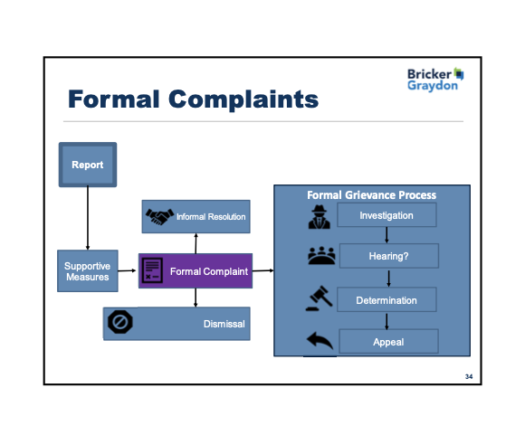
Investigation & Resolution Options

Slide 32
There are three tracks that may be pursued if a formal complaint is lodged with the Civil Rights Office.
Informal Resolution Process
Investigator Resolution Process
Hearing Resolution Process

Slide 33
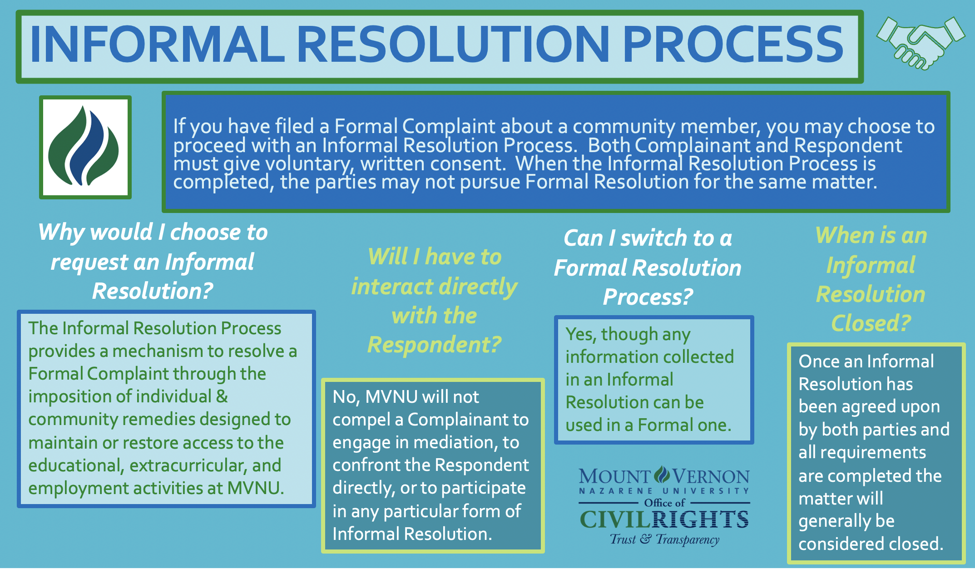

Slide 34
Investigator Role
(Section XI.G.1.)
“The Civil Rights Director will designate two investigators to conduct an adequate, reliable and impartial investigation . . . MVNU may engage an external investigator as one or both of the two assigned investigators. In complex situations, the Civil Rights Director may engage additional trained investigators to assist in gathering the information that will be considered by the primary investigators. The burden of proof and the burden of gathering evidence sufficient to reach a determination regarding responsibility rests on the University and not the parties.
The interviews will be recorded by the investigators.”

Slide 35
Investigator Role (Section XI.G.1.)
“The parties will have an equal opportunity to present witnesses, including expert witnesses, and to submit evidence. The investigators will also gather any available physical evidence, including documents, communications between the parties, and other electronic records as appropriate and available. The parties may submit questions to be asked of parties and witnesses. Investigators will review submitted questions and, in their discretion, may choose which questions are necessary and appropriate to the investigation and conduct any follow-up, as they deem relevant.”

Slide 36
Investigator Role - Review of Evidence
(Section XI.G.2.)
“The evidence obtained as part of the investigation that is directly related to the allegations raised in the formal complaint will be made available to the parties and their advisors, including the evidence upon which the College may not rely in reaching a determination regarding responsibility and inculpatory or exculpatory evidence. The parties will have 10 calendar days to review the evidence. The parties will be offered the opportunity to review the evidence and provide a written response that will be submitted to the investigators for the completion of the Investigation Report. Due to the privacy of all those involved, evidence shared in an electronic format will not be printable, downloadable or electronically shareable by the parties or their advisors. Exceptions may be made in compliance with Section 504 of the Rehabilitation Act of 1973.”

Slide 37
Investigator Role - Investigation Report
(Section XI.G.3.)
“In cases where Sexual Harassment is being alleged, the investigators will consider whether the conduct alleged in the formal complaint and the Notice of Investigation would constitute “Title IX - Sexual Harassment.” The investigators will consider the evidence gathered from the complainant during the investigation, and make a recommendation to the Civil Rights Director regarding the appropriate resolution process. The Civil Rights Director will review the recommendation of the investigators and make the final determination as to whether the conduct alleged , if demonstrated by a preponderance of the evidence, would constitute “Title IX - Sexual Harassment.” This determination is made only considering the information provided by the complainant, regardless of other evidence available in the case.”

Slide 38
Investigator Role - Investigation Report
(Section XI.G.3.)
This would be part of your review in an adjudication or appeal
Overview of the complaint made and summary of the investigative methodology
Summary of relevant information gathered, including:
  timeline of incident being investigated;
  complainant’s account of events;
  respondent’s account of events;
  witness accounts;
  evidence gathered;
Areas of agreement;
Areas of disagreement;
Assessment of whether or not the complaint meets one or more of the required elements of the definition of sexual harassment under Title IX, including rationale; and
Appendix containing all the collected evidence.

Slide 39
FINAL TIX Assessment & Appeal
(Section XI.G.4.)
“Parties have 3 business days after receipt of the investigative report to submit in writing an appeal of a determination regarding whether the conduct constitutes “Title IX - Sexual Harassment.” The appeal will be considered by an appropriately trained staff member designated by the Civil Rights Director . . . The appeal decision will be communicated in writing to the parties, their advisors, and the Title IX Coordinator. The decision will also indicate the path for complaint resolution: Hearing Resolution or Investigator Resolution.”

Slide 41


Read the Final Investigation Report
Is there sufficient information to support a finding of responsibility?

Slide 42

Investigator Resolution Process –
Non-Title IX – Sexual Misconduct
(Section XI.G.5.)
DETERMINATION
“The investigators will make a determination, by a preponderance of the evidence, whether there is sufficient information to support a finding of responsibility. The investigators’ finding, and the rationale for the finding, will be included in the final investigative report that will be shared with the parties by the Title IX Coordinator.”

Slide 43
Investigator Resolution Process –
Non-Title IX – Sexual Misconduct (Section XI.G.5.)
DETERMINATION: EVALUATING THE EVIDENCE
“The investigators should first evaluate the quality of the evidence. The investigators should consider all of the evidence regardless of who provided it. Any evidence the investigators find to be of high quality should be given more weight than any evidence the investigators find to be of low quality. Quality may, or may not be identical with quantity, and sheer quantity alone should not be the basis for a finding of responsibility. The testimony of a single party or witness may be sufficient to establish a fact.”

Slide 44
Investigator Resolution Process –
Non-Title IX – Sexual Misconduct (Section XI.G.5.)
DETERMINATION: CREDIBILITY ANALYSIS
“The investigators will evaluate all admissible, relevant evidence for weight or credibility. Credibility is not based solely on observing demeanor, but also considers detail, interest or bias, corroboration where it would reasonably be expected to exist, the circumstances of the disclosure, and the nature of the relationship.”
“The degree to which any inaccuracy, inconsistency, or implausibility in a narrative provided by a party or witness should affect a determination regarding responsibility is a matter to be decided by the investigators, after having the opportunity to ask questions of parties and witnesses, and to observe how parties and witnesses answer the questions posed by the other party. Corroborating evidence is not required.”

Slide 45
Investigator Resolution Process – Adjudication (Section XI.G.5.)
For reports against students or student groups, the Adjudicator is typically the Vice President of Student Life.
For reports against staff, the Adjudicator is typically the Vice President of Finance and Administration.
For reports against faculty, the Adjudicator is typically the Vice President of Academic Affairs.

Slide 46
Investigator Resolution Process – Adjudication
(Section XI.G.5. and XI.G.H.)
FACTORS CONSIDERED IN SANCTIONING:
the respondent’s prior conduct history;
how MVNU has sanctioned similar incidents in the past;
the nature and violence of the conduct at issue;
the impact of the conduct on the complainant;
the impact of the conduct on the community, its members, or its property; (
whether the respondent has accepted responsibility for their actions;
any other mitigating or aggravating circumstances, including MVNU’s beliefs and values.

Slide 47

Hearing Resolution - Title IX

Slide 48
Hearing Resolution Process – TIX
(Section XI.G.6.)
“A Hearing Resolution will be used to resolve cases that include charges of Sexual Harassment - Title IX.
“A Hearing Resolution includes a pre-hearing conference, a live hearing, decisions about responsibility and sanctioning by the Hearing Chair, and an optional appeal process.”

Slide 49
Hearing Resolution Process – TIX
(Section XI.G.6.)
HEARING CHAIR
The trained, impartial Hearing Chair will conduct the live hearing. This person facilitates the hearing, determines the order and flow of the hearing, makes decisions regarding relevance prior to a question being answered, makes the finding, and instances where the respondent is determined responsible, assigns the sanction/s.

Slide 50
Hearing Resolution Process – TIX
(Section XI.G.6.)
PRE-HEARING CONFERENCE
Each party will have their own pre-hearing conference.
The CRD, the Hearing Chair, and the advisor must be in attendance.
The advisors must share with the Hearing Chair their list of witnesses to appear at the hearing
The Hearing Chair may, at their discretion, add names of other witnesses contained in the report for the purpose of appearing at the hearing and submitting to cross examination.

Slide 51
Hearing Resolution Process – TIX
(Section XI.G.6.)
LIVE HEARING
“The Hearing Chair will provide an introduction detailing the purpose of the hearing, have those present identify themselves and their role, remind all parties of the expectation to be candid and honest in their response, and provide a brief overview of the procedure and the anticipated order of the hearing.”

Slide 52
Hearing Resolution Process – TIX
(Section XI.G.6.)
CROSS EXAMINATION
“The advisors will be responsible for orally asking relevant questions, including those questions which challenge credibility, to the other party or parties and any witnesses directly, in real-time and in a manner that, in the Hearing Chair’s sole discretion, is not inappropriate, harassing, intimidating, irrelevant, or redundant.”

Slide 53
Hearing Resolution Process – TIX
(Section XI.G.6.)
RELEVANCE
“Relevant questions are those tending to prove or disprove a fact at issue . . . Before a complainant, respondent, or witness answers a question by an advisor, the Hearing Chair will first determine whether the question is relevant and briefly explain any decision to exclude a question as not relevant, or request rephrasing of the question. The Hearing Chair is not required to give a lengthy or complicated explanation of a relevancy determination during the hearing. The Hearing Chair may later send to the parties any revisions to the explanation of relevance that was provided during the hearing.”

Slide 54
Hearing Resolution Process – TIX
(Section XI.G.6.)
DECISION, FINDING, SANCTION
Decisions regarding responsibility will be made by the Hearing Chair and communicated to the parties and their advisors in writing within 15 business days from the conclusion of the live hearing. The Hearing Chair will also determine the sanctions. In determining the sanctions, the Hearing Chair will consult with the appropriate University staff member.

Slide 55

Hearing Resolution Process – TIX
(Section XI.G.6.)
Identification of the allegations potentially constituting policy violations
Description of the procedural steps taken from the receipt of the formal complaint through the determination, including any notifications to the parties, interviews with parties and witnesses, site visits, methods used to gather other evidence, and hearings held
Summary of statements made at the hearing
Findings of fact supporting the determination
Conclusions regarding the application of the Policy to the facts
Statement and rationale as to the finding for each allegation, including a determination regarding responsibility
Disciplinary sanctions imposed on the respondent
Whether additional remedies will be provided to the complainant
Opportunity for appeal
WRITTEN DECISION LETTER

Slide 56

APPEAL Process –
Hearing & Investigator Resolution (Section XI.I.)
In a request for an appeal, the burden of proof lies with the party requesting the appeal. Grounds for Appeal:
Procedural irregularity that affected the outcome of the matter;
New evidence that was not reasonably available at the time the determination regarding responsibility or dismissal was made, that could affect the outcome of the matter
The Civil Rights Director, investigator(s), or Hearing had a conflict of interest or bias for or against complainants or respondents generally or the individual complainant or respondent that affected the outcome of the matter
The decision of the investigators under Section XI.G.5, the Hearing Chair under Section XI.G.6, or the adjudicator under Section XI.G.5. was clearly erroneous based on the evidential record

Slide 57

Information & Resources
MVNU’s Policy and Flow Chart can be found at this web address:
https://www.mvnu.edu/titleix
US Dept of Education Office for Civil Rights Blog: https://www2.ed.gov/about/offices/list/ocr/blog/index.html
Bricker & Eckler’s Resource Center - DCL’s, Regulations, Clery Statutes, etc.: https://www.bricker.com/resource-center/title-ix
Christina A. Jones Contact Info:
  Off Campus: 740-399-8250 / On Campus: 740-399-9000, ext. 3250

