Slide 1
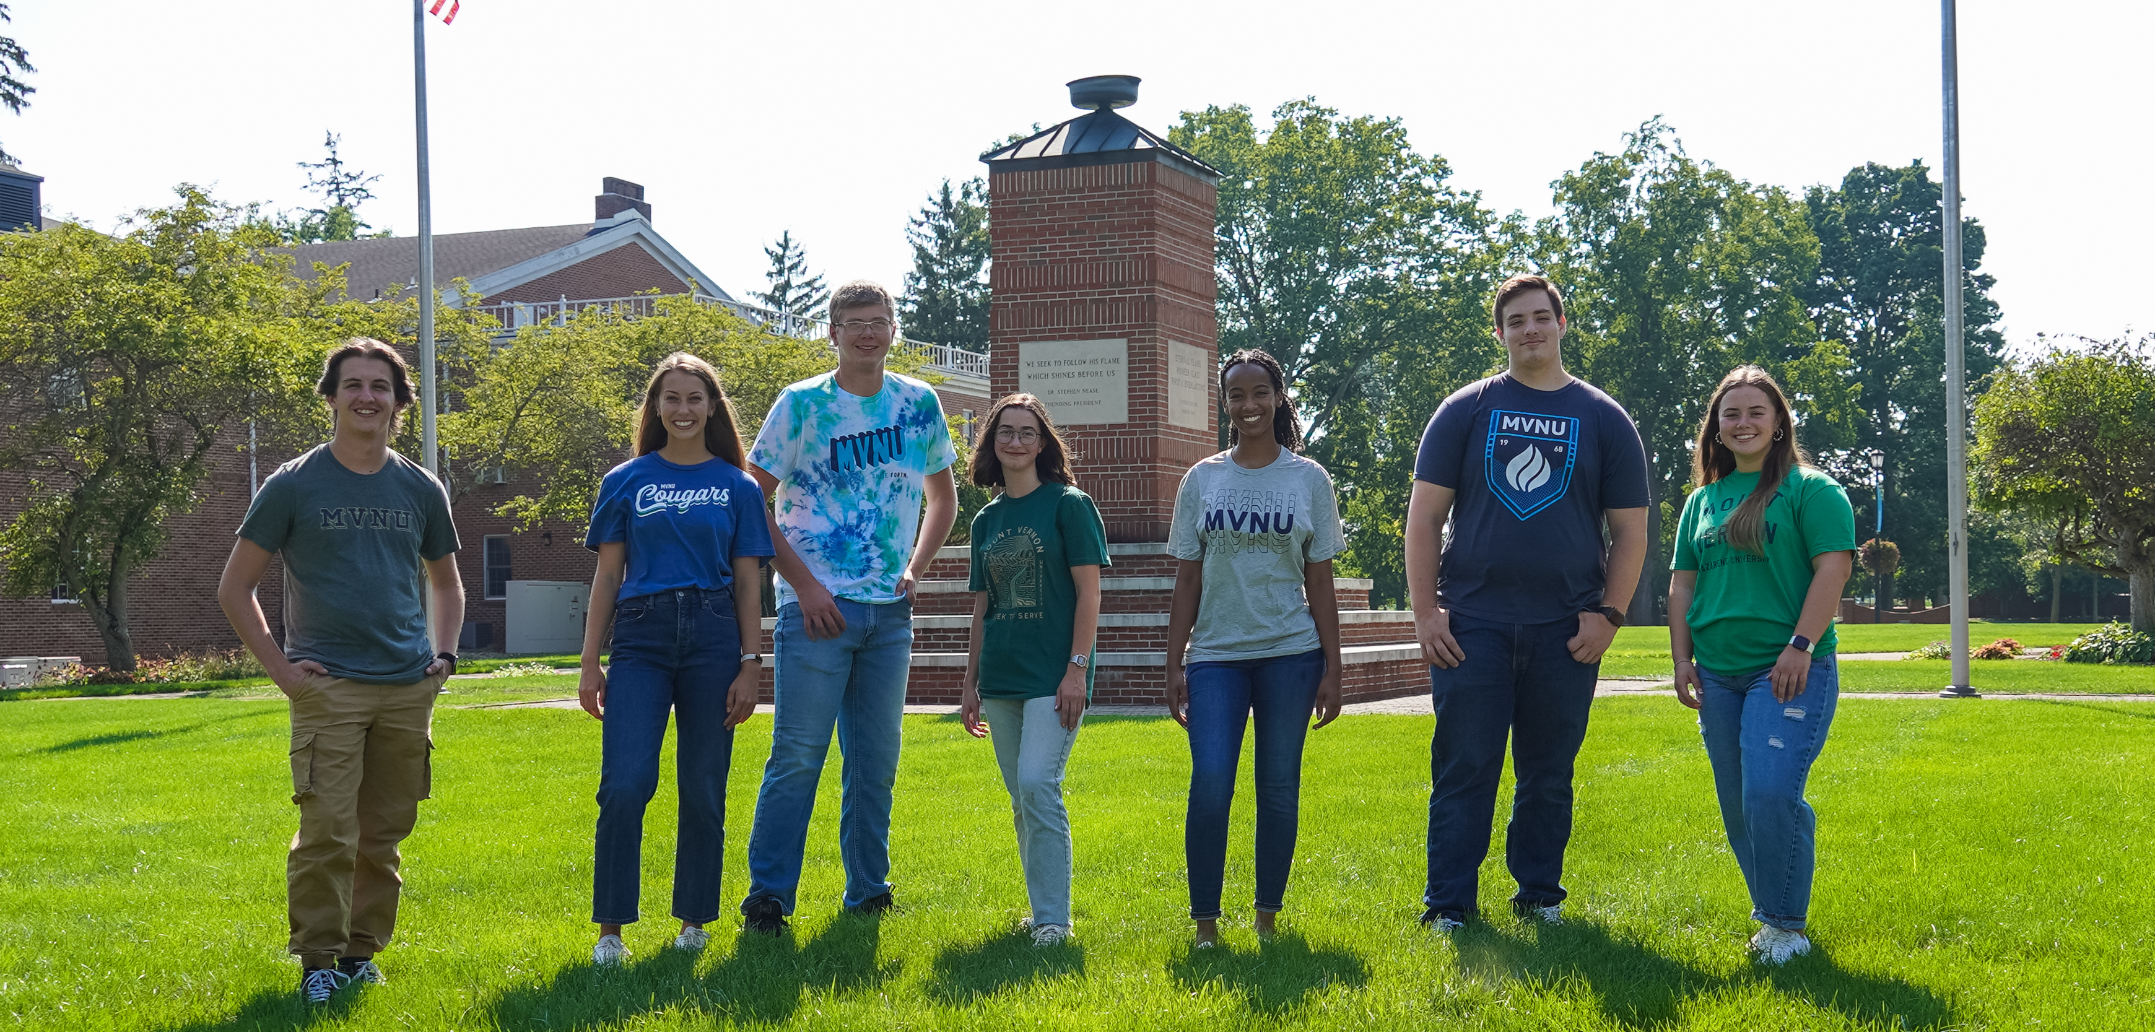
IS COMING TO VISIT…
Church/Date/Event Info Here

