Slide 1
New Student Orientation

Slide 2
Tracy Waal
Vice President for Student Life
Notes:
TRACY: Welcome, parents, guardians, aunts, uncles, and grandparents, to New Parent Orientation. We have a great and informative day planned for you and your student. This is the next step in your student’s growth and independence. We feel honored to be a part of the journey with them. Our desire is that your student will grow and mature in their faith, identity, integrity, and purpose during the time that you’ve entrusted us with them.
Let’s start by introducing yourself to one other parent sitting in proximity. (parents meet)
Let me give you a little bit of my background for context. I grew up a shy kid on a farm in Iowa. I graduated from college with no confidence and moved back home to shingle houses. Two men saw in me God-given potential that I didn’t see. They saw the gifts that God had given me far before I ever did. They pushed me and shaped me and it literally changed the course and direction of my life. MVNU brings that same intentionality to everything we do. We want to help student reach their God-given potential!

Slide 3
Sarah Mowry
Assistant Director of Res Life and RD
David Calvarese
Resident Director
Notes:
TRACY: (Introduces Sarah and David)

Slide 4
Student Sessions
Academics
Student Life
Residence/Commuter Life
Notes:
SARAH: To start us off I just want to keep you aware of what your students are doing today. Just so you know, here’s what their day will look like in a nutshell:
ACADEMICS - They will meet with their advisor and talk through which classes they’re taking.
STUDENT LIFE - They’ll meet with student life and discover the many ways in which they can be involved in extracurricular and ministry opportunities (plug in and connect with campus). I encourage you to ask them about that!
RESIDENCE/COMMUTER LIFE - They’ll be looking at their dorm rooms, possibly meeting their roommate. (By the way, the dorms will be available for you to view at the end of the day.) Commuters will have a separate session during that time as well.
At the end of the day, you’ll rejoin your student in the chapel. We have a meaningful way of welcoming every new student to our campus that you won’t want to miss.

Slide 5
www.mvnu.edu/parents
To download this entire PowerPoint presentation and the MVNU Parent Handbook
Notes:
SARAH:
We know that just like for your students, this is a big day with a lot of information for you all as well. Please know that this PowerPoint presentation will be available on our website along with other helpful resources, so don’t worry about jotting everything down. You can go to this link here at any time to revisit information given today.

Slide 6
Reading the PowerPoint
Everything you see
Everything we say
Notes:
SARAH:
When you download the PowerPoint, take note: Everything you see on the screen today will be in the slide deck. But everything we say – our script – is included in the notes section under the slide.

Slide 7
Required of all new students:
Move In Day
August 25
New Student Institute
August 26-28
Classes Begin
August 29
Notes:
SARAH: Here are important dates for you to remember. All new students – commuters and transfers included - are required to be at all of these events.

Slide 8
Parent Session 1
Nuts and Bolts
Parent Session 2
Transitioning Well
Notes:
TRACY: Parent Session 1 is about the nuts and bolts of being a student and what your student needs to do. What are the next steps to becoming a student? What forms are needed? What are the deadlines and key dates? What are the resources that students need to be successful on campus?
In Parent Session 2, we’ll cover many items that will help your student transition to college well. It’s not uncommon for students to be thrown off by the transition – even the most excited of extroverts. We’ll talk a little bit about what to expect as the transition takes place…what your student may be feeling…what you may be feeling…the challenges you might face over the first year. You’ll leave with a good understanding of how MVNU will partner with you to develop your student and set him or her up for success.
IMPORTANT NOTE: It’s important for you to know that your student may not get all the information that you’re getting today, at least not in the detail that you’re getting it. That’s intentional. We’ve discovered over the years, that when we give students all the information they need to succeed as a student in June, that they forget it when they need it in September. They’re getting basic information now. They will get the information they need right before school starts, probably in even more detail than you’re getting right now. They’ll get it at New Student Institute, right after they move in. NSI is designed to set them up for success.

Slide 9
Parent Session 1
Campus Ministries
Student Success
Financial Aid
Residence Life
FERPA
Academic Calendar
Notes:
TRACY: In the next hour, here are the things we’ll be covering.

Slide 10
Purpose:
Create an environment where students can reach their God-given potential
Notes:
TRACY: Student Life exists to create an environment where students can reach their God-given potential.
College is a challenge. If it wasn’t a challenge, no one would see the need to go. Get it into your mind that there will be some rough spots, some tears, and some immovable objects in your student’s future. And also, accept the fact that that those things are necessary to shape your student into the person they need to be to reach their God-given potential.
Who of us, in this room, has grown without challenges? None of us. Our challenges help us to grow and they also reveal how much we need to grow. Expect that of your students’ first year in college.

Slide 11
Commitment to Community
Our Commitment to Community allows us to bring out the best in each other and when practiced, helps shape the Christ-like character toward which we strive.
affirmations
We love God.
We respect others.
We believe in personal responsibility.
Notes:
DAVID: Shares story of his enrollment at MVNU and the impact it had on his life.

Slide 12
Commitment to Community
These are the things our community stands for:
Commitment to spiritual growth and character formation
Expression of Christian values through responsible decisions and actions
Honesty and integrity in our academic, personal, and social lives
Pursuit of habits that promote self-control
Healthy interpersonal, sexual, and romantic relationships
Personal responsibility in decision making
Transformation through engagement and collaboration
Notes:
DAVID: Introduces Stephanie

Slide 13
Stephanie Lobdell
Campus Pastor
Notes:
STEPHANIE:
“Hi friends! My name is Pastor Stephanie, and I am the Campus Pastor here at MVNU. I am thrilled about your family’s decision to send your student to our school. As you know, MVNU is a Christian university, and we are not Christian in name only. Everything that we do is centered around growing in our love for Christ and neighbor. And this Christian identity is so important to us that students participate in campus-wide spiritual formation their entire 4 years here. This includes Chapel 2 to 3 times a week, but also smalls groups, community service and many other intentional activities intended to help your student grow in their faith.
“Now it is my deepest desire, as well as the desire of all faculty and staff to send students forth into the world with a heart that is centered on God and a desire to serve God in whatever vocation they pursue. Now I look forward to working with your student from wherever they are in their faith. Ours is not a one size fits all program, and my team is always available to work with our students as they learn and grow, wrestle even sometimes question and doubt.
“Now we are already praying for your students, and I look forward to meeting them in person very soon.”

Slide 14
Spiritual Formation Plan
30 spiritual formation credits per semester (approx. 80+ available per semester)
33 through M-W-F 10:20 AM Chapel
10 through Freshman Belong Groups
10 through CoSMO (Community Service)
10 through Justice Talks
8-12 through Worship Nights
Wellness Initiative
Notes:
STEPHANIE: At MVNU, we’re intentional about developing students, not just in academics, but in body, soul, mind, and spirit. That means we have an intentional spiritual formation plan.
Most intentionally Christian universities require (or at least offer) some sort of corporate worship chapel experience. We do that too. However, we take spiritual formation beyond that because of our belief that true spiritual formation requires more than being a part of the corporate worship service.
Each semester, students are required to get 30 spiritual formation credits. Freshmen have 75+ available.
CHAPEL (corporate worship) - We believe that corporate worship is an important part of spiritual formation, so we offer M-W-F chapel services where students can earn one credit for each one attended. The entire campus shuts down for an hour to allow this to happen.
SMALL GROUPS - We also understand that spiritual formation isn’t complete without accountability and sharing, which is why we give 10 credits for being a part of a small group sponsored by the Campus Ministries office.
COSMO (Community Service and Ministry to Others) - We also believe that spiritual formation happens through service to others, which is why credit is given for being a part of a CoSMO Community Service group sponsored by the Campus Ministries office.
JUSTICE PROJECT: intersection of faith and issues of justice in society
WELLNESS - The Wellness Initiative is a program designed to give students a clear understanding of balance and rest as it relates to their spiritual formation.
What you’re seeing on the screen is the requirement for freshman students. The requirements become slightly lower as students progress academically through their sophomore, junior, and senior years.

Slide 15
Joy Strickland
Assistant Vice President for Student Success and Retention

Slide 16
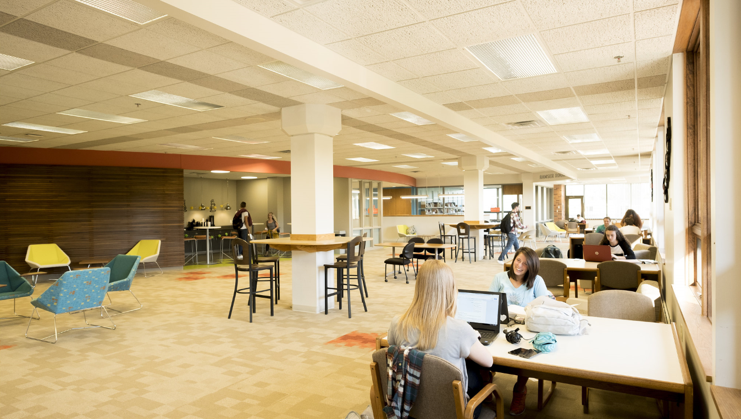
CENTER FOR STUDENT SUCCESS
Notes:
Welcome to the MVNU family! I’m excited to share with you today about the services and opportunities available to students through Student Success and Retention offices and programs. Our mission is to empower students to envision and attain their academic, personal, and vocational goals through self-knowledge, effective learning, and individualized support.
This department includes the Center for Student Success, Accessibility Services, the Test Center, Career Development, and the Library.
All of our offices are located in the Thorne Library and Resource Center, with most on the main floor. We’ll start there with the Center for Student Success.

Slide 17
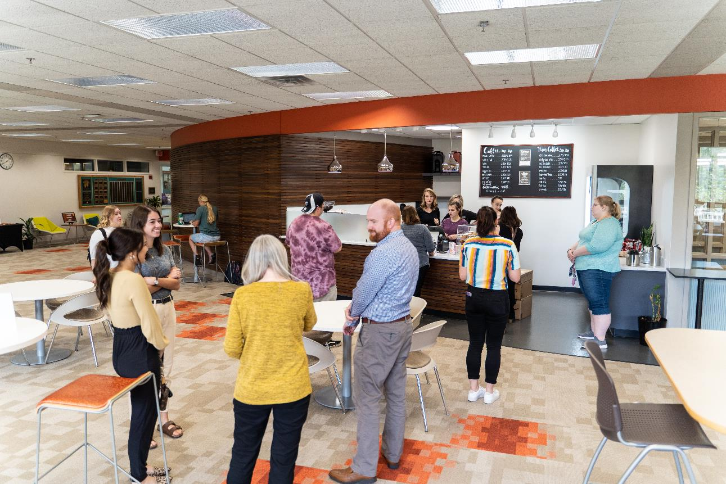
CENTER FOR STUDENT SUCCESS
Notes:
Another very important element of our space is the campus Happy Bean coffeeshop and a grab and go food station as students need a lot of sustenance when they are studying! There are a variety of seating options conducive for students meeting with a peer tutor, participating in a group study session, studying on their own, connecting with a faculty or staff member, or hanging out with friends

Slide 18
The Center for Student Success provides academic enrichment resources, accessibility support, and the university test center. Location: Main Floor of the Library.
Director: Dr. Lee Chambers (Lee.Chambers@mvnu.edu)
Academic Enrichment
Supplemental Instruction (SI) - Regularly scheduled class review sessions for many challenging first and second year courses. Student SI leaders collaborate with faculty on session content.
One-on-One Tutoring - Student peer tutors meet individually or in small groups to provide personalized assistance in many first and second year courses.
Academic Peer Mentors - Academic Peer Mentors assist students in improving time management skills, organizational abilities, proofreading, and study strategies.
CENTER FOR STUDENT SUCCESS

Slide 19
CENTER FOR STUDENT SUCCESS
Academic Enrichment Continued...
•The Writing Lab- Creates a safe and friendly space for writers of all levels to share their work and receive thorough and considerate feedback from attentive peer tutors. The Writing Lab is supervised by an English professor so the tutoring is targeted and seamless with the classroom experience.
The Center for Student Success also offers several first year credited courses that help new students successfully transition to the academic demands of higher education. Additionally, they run a four year Nease scholars program that begins with a summer bridge program called, The Nease Institute. Please see www.mvnu.edu/undergraduate/academics/css for more details about each of these opportunities.

Slide 20
CENTER FOR STUDENT SUCCESS
Accessibility Services
Accessibility Services facilitates equal access to all institutional opportunities for students who self-disclose a documented disability. MVNU fosters an accessible, inclusive, and compliant campus environment. To learn more about the accommodations process and request accommodations, please visit mvnu.edu/accessibilityservices.
The Test Center
Located on the third floor of the Thorne Library.
•Quiet and secure testing environment for students with accommodations or other scheduled tests
•PearsonVUE authorized
•Limited hours during summer and school breaks
•Questions or appointment scheduling, please email: testcenter@mvnu.edu
Notes:
If your son or daughter had a 504 or IEP plan in high school, I strongly encourage them to complete the accommodations process at MVNU this summer so Accessibility Services can share with them the reasonable accommodations available to them. Accommodations are not retroactive so having accommodations in place by the start of the fall semester is highly recommended.

Slide 21
CAREER DEVELOPMENT
Located on the main floor of the Thorne Library.
Director: Mr. Gary Swisher (Gary.Swisher@mvnu.edu)
Provides students with guidance and resources in:
Identifying suitable majors
Planning their careers
Obtaining jobs and internships
Services include: individual advising, career assessments, career exploration, graduate school information, job postings, resume guidance, interviewing, and networking.
Career Development also offers in the fall CSS-2012 Career Planning & Preparation, a credited course that helps student explore or confirm a best fit major and career calling.

Slide 22
THORNE LIBRARY AND RESOURCE CENTER
Director: Mr. Tim Radcliffe, Assistant Professor (Timothy.Radcliffe@mvnu.edu)
The Library provides access to:
In-house physical collections (books, periodicals, media, etc.)
OhioLINK resources (books, online databases, eArticles, eBooks, media, etc.)
Study rooms (individual and group)
Extended hours room for after-hours study
Computer labs
Friendly, helpful library staff
Notes:
Thank you for the chance to share about Student Success and Retention.

Slide 23
Center for Student Success
Joy.Strickland@mvnu.edu
740-392-6868 x4281

Slide 24
Vickie Williams
Director of Student Financial Services

Slide 25
STUDENT FINANCIAL SERVICES
Student Accounts and Financial Aid
Provide services and address questions regarding:
Scholarships
Grants
Student Loans
Student Account

Slide 26
STUDENT FINANCIAL SERVICES
Student Accounts and Financial Aid
Services include:
Cash checks up to $200
Process payments to Student Account
Account viewable on student portal
Account determined by current student schedule

Slide 27
STUDENT FINANCIAL SERVICES
Student Accounts and Financial Aid
Payment Options:
Full payment
Cashnet monthly payment plan
Private or parent loan
Combination of payment options

Slide 28
STUDENT FINANCIAL SERVICES
Student Accounts and Financial Aid
Payment Deadline
August 10
(for fall semester)

Slide 29
STUDENT FINANCIAL SERVICES
Student Accounts and Financial Aid
Communication
All communication from SFS will go to the student’s email
No paper statement or bill will be mailed
Person proxy-gives you access to your student’s information
FERPA applies to account and financial aid information

Slide 30
Student Financial Services
Financial.Aid@mvnu.edu
740-392-6868 x4520

Slide 31
Sarah Mowry
Assistant Director of Res Life and RD
David Calvarese
Resident Director

Slide 32
Residence Life
RESIDENCE HALLS
Pioneer & Galloway: Females
Oakwood: Males
Hall Features: 2 residents/room; shared bathroom on floor
UPPERCLASSMEN RESIDENCES
Birch Apartments
Cedar Apartments
Cypress Apartments
Elmwood Apartments
Galloway Hall
Maplewood Apartments
Redwood Hall – Suite-style
Rosewood Apartments
Spruce Apartments
Apartment Features: 3 bedrooms, 1.5-2 bathrooms, living room & kitchenette housing 6 residents
Residential Requirement
Notes:
DAVID- So we know this is a lot of information being thrown at you, and the sessions your students are in. We as Res Life are in place purposefully for several reasons, but one of those is to be there to answer the questions after today, to be constant support and help to answer and assist your students once they are moved in. So depending on if your student is coming in as a freshmen or transfer, here are the areas they may be living in.
(Explains areas)

Slide 33
Residence Life Team
PROFESSIONAL STAFF: 6 RESIDENT DIRECTORS (RDs)
Oakwood Hall: David Calvarese
Galloway Hall: Cara Boyd
Pioneer Hall: Haley Conrad
Apartments: Sarah Mowry, Elijah Arns, & Michaela Bruce\
STUDENT STAFF: 30 RESIDENT ASSISTANTS (RAs)
One RA per floor/apartment block
One Student Mentor (SM) per floor in our residence halls
Notes:
DAVID cont:
An RD is a full time employee that is living in the areas as your students, overseeing a staff of Resident Assistants and Student mentors. An RA (Resident Assistant) is an upper classmen student trained to be a support and help students, whether in the freshmen areas or upperclassmen areas. Student Mentors are specifically in freshmen areas as an extra support and oversee freshmen belong groups.
Ultimately, or goal as Res Life, is to develop interdependence of students and help them grow and transition in a healthy way, through our staff, through our programming, and in connecting them to other opportunities provided on campus.
Sarah:
Now where do you land in all of this? We have this support built in to their Residential Life experience for a reason! We have many students, with many adjustments and changes going on while getting used to college life on MVNU campus. At the beginning of the year we walk them through how they can talk to their RA’s and the RDs, and that we even have a process in place to help walk through issues that commonly arise, such as roommate tensions, academic resources, aka where to find them, reaching out to the counseling center, and even how to find out events going on. We know how stressful it can be to students to have so many new things shifting into college. What we encourage you to do, when your student come to you with things going on, is to ask them “Have you talked to the right people on campus yet?” This is why we are sharing to you what an RD is, what an RA is. We are hoping to give you the tools and terminology that your students will be familiar with so that when they come to you, you can use these terms to help direct them to us. That is what we are here for, and by you directing them to us, ultimately you are helping us help them.
We also wanted to make it clear that Res Life is here for our commuter students as well. If you have a student who is commuting, they are welcome to any events that we have, whether it is an all Res Life event, or an area event. If you have a daughter who has friends in Pioneer, they are more than welcome to join in Pioneer events, and so on. We are here for all students, and want all students no matter where they live to get to experience this special part of college life.

Slide 34
Residence Halls Close:
Thanksgiving
November 22 at 6:00pm – November 27 at 2:00pm
Christmas
December 9 at 6:00pm – January 11 at 2:00pm
Spring Break
February 24 at 6:00pm – March 12 at 2:00pm
End of Year
May 5 at 6:00pm
Notes:
SARAH AND DAVID: It’s also important to note that throughout the year, all on campus residences will be closed at certain times. You can see those dates here. Students needing to stay on campus during this time must request to stay and will be charged an additional fee. Information and applications for this will be emailed out throughout the year.

Slide 35
Residence Life
Wendi.Lahmon@mvnu.edu
740-392-6868 x4602

Slide 36
Mel Severns
University Registrar

Slide 37
FERPA
Family Educational Rights and Privacy Act
Academic Information
Chapel Attendance Information
Financial Information
Housing Information
Notes:
FERPA stands for the Family Educational Rights and Privacy Act, which was first passed in 1974. In a nutshell, this law requires institutions of higher education to protect the identity and education records of every college student, no matter their age. When a student enters MVNU, we must protect their information. A student has to give us permission to release their education records to another person – including a parent or guardian. At MVNU, the student must give a parent or guardian their password before we can speak to them.

Slide 38
Academic Dates
Academic Calendar
Final Exam Policy
December 5-8, 2022
May 2-5, 2023
Notes:
It’s important to pay attention to the academic calendar, which is available to download on the MVNU parent’s page.
It’s extremely important for you to know our final exam expectations. We have a strict final exam policy, a portion of which I will read for you but which can also be found by Googling “MVNU final exam policy,” which is in the MVNU academic Catalog, or by going to the Portal:
“Final exam periods are scheduled by the Academic Affairs Office. Students are responsible for ensuring that personal matters (e.g., travel, work, weddings) accommodate the final exam schedule and for informing parents of final exam schedules. Students who are scheduled for more than two (2) final exams on the same day may request to have the excess over two (2) rescheduled. Forms are available on the Student Portal.” And the process follows in the Catalog.
This means that we respectfully request that you not schedule a family cruise, an international wedding, a concert event, a Broadway or off-Broadway play, or even a mission trip for any time during final exam week of any given semester. These are only examples: Your student is required take final exams at their given time, and the scheduled time may not coincide with when your student normally has class. That is, a Tuesday Thursday class may have a final scheduled for a Monday. So ask your students for their individual exam to take schedules the first week of class or look them up on the portal if you have any plans to hike the Himalayans or just go over the river and through the woods to grandmother’s house.
This year, final exams in fall are Monday through Thursday, Dec. 5-8; in spring they are Tuesday through Friday, May 2-5.

Slide 39
Required of all new students:
Move In Day
August 25
New Student Institute
August 26-28
Classes Begin
August 29
Notes:
TRACY: Here are important dates for you to remember. All new students – commuters and transfers included - are required to be at all of these events.

Slide 40
Parents are invited:
Sonfest
September 17
OAKtoberfest
October 8
Homecoming
November 11-12
Notes:
TRACY: Here are some things that you, as parents, can attend in the fall. Sonfest is our all-day Christian music festival on campus. Oaktoberfest is our fall festival on the lawn of Oakwood Hall. And Homecoming will be November 11-12 this year.

Slide 41
Parent Session 2
2:55-3:30 pm
Notes:
We will take a break now for coffee in Ariel Arena lobby. Be back at 2:55 for the final parent session where we’ll equip you to help your student make the transition so they can be set up for the best chance of success. As you leave, keep in mind that students are on the floor of Ariel Arena, meeting with professors in advising sessions, so do your best to keep the noise at a manageable level. See you at 2:55.

Slide 42
Tracy Waal
Vice President for Student Life

Slide 43
Notes:
TRACY:
Let’s talk about your student’s first year. When new students come to MVNU, we talk to them about three things and continue to build on them through the entire first year.

Slide 44
Notes:
TRACY:
If they do these three things well, they have the best chance of success at MVNU. Even today, without their knowledge, our messaging to your students falls into one of these three categories. They are essential elements of success into your students.

Slide 45
Notes:
TRACY:
Getting connected is foundational to your student’s success. We work on it right away. In fact, they’re doing a bunch of it right now. They’re making friends, building community, and learning about campus resources. We want your student to get connected in three areas: (1)people, (2)resources, and (3)technology

Slide 46
Notes:
TRACY:
For many of your students, up to this point school was about getting an “A”. That’s a good goal, but our goal is to equip students for “lifelong learning and service”. Here’s a truth: What your student learns in the classroom will be relevant for 5-10 years. If they don’t learn how to learn, they’ll be obsolete five years after they leave MVNU. Learning how to learn goes beyond the classroom and brings value for a lifetime.

Slide 47
Notes:
TRACY:
College is a transition time that reveals many things. Your students have the freedom to make choices and chart paths that you might not have had before. Interestingly, some of those choices they make and habits they establish are very basic – like when, what, and how much to eat or when and how much to sleep. Those habits can set them up for success or failure, even beyond MVNU.

Slide 48
Notes:
TRACY:
These are the things that we are intentionally building into your students lives.

Slide 49
Year 2 – Vocation
Year 3 – Service
Year 4 - Launch
Notes:
TRACY:
Each year intentionally builds on the previous. What is known as the “Second Year Project” focuses on vocation. Vocation is not just a job, but a calling with a purpose. What is your life about. In year 3, we focus on service. Then we prepare them to launch from MVNU in year 4. The programming inside and outside of the classroom work together toward where we are heading…

Slide 50
The Portrait of an MVNU Graduate
www.mvnu.edu/educationalframework
Notes:
…and this is where we’re heading. We call this our educational framework. This is what we’d like our students to be when they graduate. Scholarship, Character, and Service.

Slide 51
MVNU graduates
Embrace learning and inquiry as a joyful act of worship in response to God’s grace
Embody a commitment to developing the whole person through engaging the liberal arts
Cultivate habits of academic excellence for ardent lifelong learning
Integrate knowledge and practice in the disciplines and master essential professional skills for flourishing at work
www.mvnu.edu/educationalframework
Notes:
We won’t take the time to go through all of these, but you can take a look at the web address listed on the screen. Each of the three characteristics of an MVNU graduate are further explained. For example, you’ll see what we’re moving toward in the Scholarship characteristic.

Slide 52
Riley Wike
MVNU Student
Notes:
TRACY: So that’s where we’re headed. Right now, though, your student is heading into transition to college. Transitions can be exciting, but they can also come with challenges. It will be an adjustment for you and your student.
I’ve asked one of our current students, Riley Wike, to share his experience transitioning to MVNU.

Slide 53
Eric Browning
Director of Counseling and Wellness
Notes:
ERIC:

Slide 54
How to help your college student:
Let them be more independent
Help them prepare for failure
Help them develop healthy coping skills
Encourage them to seek help when necessary
Notes:
ERIC:
I have three kids—1 college grad, 1 finished freshman year, 1 is a full-time College Credit Plus student.
We often prepare our kids for college in the academic or financial way, but one of the most important ways to prepare students is emotionally. A recent survey of first time freshmen found 60% did not feel prepared to deal with the emotional side of college. Compared to students who felt prepared this group had lower GPA’s, felt more stress, and described their first year as “poor”.
Transition is difficult even with good coping skills, so I want to help provide a few ideas to help you help them.
Let them be more independent. This is hard for parents because we have parented for so long, but we need to move from being a parent to a consultant. Parents tell kids what to do, consultants give input then allow others to decide. A great way to do this is to ask questions rather than give direction. Instead of saying what your student should do, ask them “How will that benefit your?” or “How is that working for your?” Let them evaluate and decide, even though that means they will choose poorly, or in some cases wrongly.
That leads to the second thing—help them prepare for failure. I’m not talking about on the large scale, but how to address and persevere through smaller things. This means learning failure is not the end (catastrophizing) and how to keep going.
How to develop healthy coping skills—playing video games 14 hours a day is not a healthy coping skill. How to care for themselves in all areas (PIESS), how to communicate with others appropriately—face to face and not via text, Facebook, twitter, etc.
How to seek help. That is where the counseling office comes in. We are a great place for students to turn to if they face difficulty in almost any area of life. Our services are free and confidential for any full-time traditional undergraduate students.

Slide 55
Tracy Waal
Vice President for Student Life

Slide 56
Culture Shock
the personal disorientation a person may feel when experiencing a new way of life
Notes:
TRACY: To end today, I’d like us to take a look at the first month of college and give you some insight into what’s coming this fall. Almost no student is immune – even the student who has looked forward to college her entire life.
Whatever environment your student is accustomed to right now, whether they like that environment or not, that environment has become their way of life. It’s the safe, automatic, in some ways predictable, or at least familiar way to get what they want.
We often think of culture shock as being involved when we go to a different country, but college is a new way of life! Almost every student experiences culture shock when they transition to college. Students just experience it at different levels.

Slide 57
Information overload
Language barrier
Technology gap
Homesickness
Boredom
Loneliness
Depression and sadness
Irritability
Anxiety
Self-doubt
Irritability
Fatigue/Sleep deprivation
Signs of Culture Shock
Notes:
These are the signs of culture shock. Extroverts become lonely. Optimists become critical. Students who have been leaders in high school begin to have self doubt. Students who couldn’t wait to get away from mom and dad are suddenly homesick. Happy students begin to seem sad.
Students are experiencing these things for the first time so don’t know how to handle them. They assume something must be wrong, when in reality, they’re experiencing something completely normal for the very first time. They’ll try to convince themselves that this is different, because they went on a spring break trip with their high school friends and they didn’t experience any of these emotions. “I’m not myself, so this must be the wrong place for me.”
Parents, take note: CULTURE SHOCK IS OFTEN THE FIRST CHALLENGE OF A STUDENT’S COLLEGE EXPERIENCE! The first challenge provides the first opportunity for growth that will lead to your son or daughter developing his or her identity, building integrity, and developing purpose in life. Do everything in your power to avoid short circuiting the growth that your student will experience by working through it.
Let’s talk about what to expect with your student:

Slide 58
Culture Shock
Honeymoon
Excitement with new things
Superficial involvement with culture
Interest in learning; very motivated
Notes:
When you drop your student off, you’ll probably witness the honeymoon. There’s anxiety, but there’s also excitement and interest. Your student might have 10 friends in the first 10 minutes.

Slide 59
Culture Shock
Negotiation
Newness wears off
Primary focus on differences
Small differences feel like major issues
Homesickness
Notes:
Then, the newness fades. Your students eyes are drawn to the way things are different:
-I’m not used to eating with so many people.
-This place is so big compared to my high school!
-This place is so small compared to my high school!
-I don’t sleep as well as I’d like without my dog close by.
-This is the worst bed in the history of the world!
-Having a different schedule every single day is confusing.
-This workout center doesn’t have the same equipment as the one back home.
-I’m not used to looking at my syllabus to determine when I have a test.
-It’s so far to walk between classes.
-I wish I was at a place where I knew more people.
-My calculus professor doesn’t teach the same way as Ms. Jones did.
Many of the things that they focus on are true of any college experience. This is when students are tempted to throw in the towel. This is the period where you’ll be tempted to bail them out. This is the period where growth either comes (in the form of perseverance) or it doesn’t.

Slide 60
Culture Shock
Adjustment
Become more familiar with cultural cues
“I’m here; I should make the most of it.”
Feel more comfortable and less isolated
Sense of humor returns
Notes:
But if they persist, there’s a turning point. Sometimes it starts with a very weak statement of commitment to themselves: “I guess I made my choice and I’m here, so I should try to make the most of it.” Know that they’re likely in the adjustment phase and things will likely be looking up soon.

Slide 61
Culture Shock
Adaptation
Feeling at home
New culture is no longer new
Able to live to your full potential
Notes:
Finally, students adapt. This becomes their home away from home. The new stuff is no longer new, it’s now just normal stuff. They feel stability and begin to grow and thrive.

Slide 62
September 20
First evening residential students can go home overnight
Notes:
It’s important to note that all new students are required to stay on campus through the first three weeks of the semester. We do this because we know that the majority of our students need to be here that long to work through the negotiation phase. Know that when it happens, we’ll be there working through this with your student!

Slide 63
Parent Resources
Helping Your Child Transition to College
https://collegeparents.org/2016/08/26/helping-your-child-transition-to-college/
The Crucial First Week of College Classes
https://www.psychologytoday.com/us/blog/head-the-class/201508/the-crucial-first-week-college-classes-get-good-start
How to Deal with Homesickness at College
https://www.cnbc.com/2018/09/07/how-to-deal-with-homesickness-at-college.html
Adult Skills Every 18-Year-Old Should Have
https://qz.com/644491/a-stanford-dean-on-adult-skills-every-18-year-old-should-have/

Slide 64
Drive to chapel for the closing session.

Slide 65
New Student Orientation

