Slide 1


Athletics Department
Training 2023

Slide 2


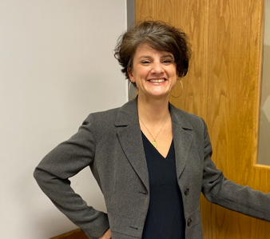
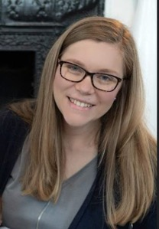
Civil Rights Director
Christina Jones, J.D.
Lakeholm 109
Katie Sherman, Deputy TIX Coordinator

Slide 3


Religious Expression
Who We Are and What We Believe
Being of Wesleyan heritage, and a ministry of the Church of the Nazarene, we strive to be a learning community where grace is foundational, truth is pursued, and holiness is a way of life. Furthermore, we attempt to make all policies and decisions within the doctrinal and moral convictions of the Church of the Nazarene as articulated within the Manual of the Church of the Nazarene (e.g., Articles of Faith, Covenant of Christian Conduct including the Statement on Human Sexuality and Marriage, Covenant of Christian Character, and the agreed upon Statement on Discrimination, 915). We also strive to provide a learning and living environment that promotes safety, transparency, personal integrity, civility, mutual respect and freedom from unlawful discrimination.
This integration of faith and learning is recognized by the United States and Ohio Constitutions and many state and federal laws. Therefore, it is a recognized right of religious educational institutions such as MVNU to incorporate religious beliefs into all aspects of university life and maintain faith-based standards of behavior which all community members voluntarily agree to follow.
MVNU seeks to recruit students of the Christian faith and to create an institutional environment conducive to their growth in Christ; however, we do not require that students be confessing Christians. We welcome and value students of every background and faith. As a Christian community, we expect that all of our students will respect the nature of our community, learn about our traditions and participate in our community practices. MVNU affirms that a Christian liberal arts education includes an understanding of and appreciation of the differences in faith, living, and practice.
Be a Good Neighbor

Slide 4

Notice of Non-Discrimination
Mount Vernon Nazarene University is committed to fostering a non-discriminatory campus environment in which community members can learn and work. MVNU prohibits discrimination on the basis of race, sex, age, color, national origin, disability, marital status, or military service in the operation of all University programs, activities, and services. As a faith-based institution, the University is exempted from certain laws and regulations concerning discrimination. The University maintains the right, with regard to its lifestyle covenant, employment, and other matters, to uphold and apply its Christian beliefs related to, among other issues, marriage, sex (gender), gender identity, sexual orientation, and sexual activity to the fullest extent permitted by law. Thus, MVNU attempts to make all policies and decisions within the doctrinal and moral convictions of the Church of the Nazarene (e.g., Articles of Faith, Covenant of Christian Conduct including the Statement on Human Sexuality and Marriage, Covenant of Christian Character, and the Statement on Discrimination, 915).

Slide 5

Civil Rights Policies
Discrimination, Harassment, Sexual Misconduct
Pregnancy Accommodations and Related Conditions
Resolving Complaints under ADA/Section 504
Find these at www.mvnu.edu/titleix

Slide 6

MVNU is committed to fostering a climate free from discrimination and harassment, through clear and effective policies, a coordinated education and prevention program, and prompt and equitable procedures for resolution of reports of conduct prohibited under this policy. The University encourages all members of its community to participate in the process of creating a safe, welcoming and respectful environment on campus.
Title VI, 42 U.S.C. § 2000d et seq., was enacted as part of the landmark Civil Rights Act of 1964. It prohibits discrimination on the basis of race, color, and national origin in programs and activities receiving federal financial assistance.
Title VII, 42 U.S.C. § 2000e et seq., of the Civil Rights Act of 1964 helps protect individuals from discrimination in the workplace. It prohibits employment discrimination based upon race, color, national origin, sex and religion. Title VII also protects against harassment, which can be any physical or vocal conduct that creates an intimidating, hostile or offensive work environment. Conduct can be harassment if it interferes with a person's work performance.
Title IX, 20 U.S.C. §1681 et seq., of the Title IX of the Education Amendments of 1972 protects people from discrimination based on sex in education programs or activities that receive federal financial assistance.
ADA (The Americans with Disabilities Act of 1990), 42 U.S.C. §12101 and the Rehabilitation Act of 1973, Section 504 is a civil rights law that prohibits discrimination against people with disabilities in programs that receive financial assistance

Slide 7

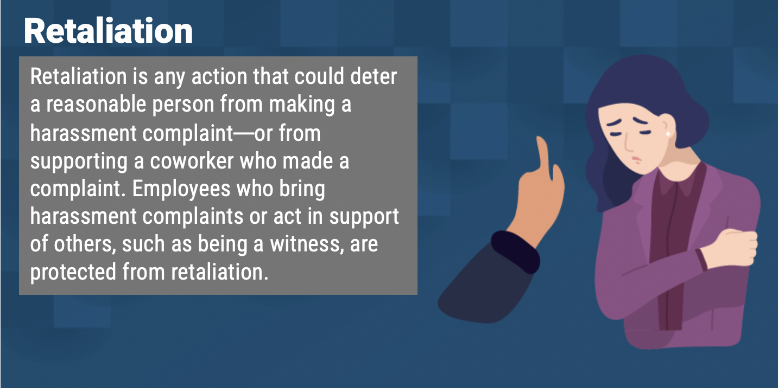

Title VI
Title VII
Title IX
ADA/504
Applies to all
students & employees
The Civil Rights Office is a policy driven entity and is designed to ensure that all its community members are free from discrimination and harassment as required by law and the University policies. The Policy prohibits specific forms of behavior, which the Policy collectively refers to as “Prohibited Conduct.”

Slide 8

The RIPPLE Effect of Harassment
Just like a stone thrown into a pond, small actions can create ripples that spread out far beyond the first splash. With harassment, we often think about that first splash: the harsh confrontation, the initial hurt feelings, or even the physical wounds. We seldom see how that first splash might reverberate out in surprising ways.
Disrespectful behavior can have negative academic, emotional, social, and health consequences for all involved. And, without, intervention, those consequences can spread and grow.
- United Educators

Slide 9


Racial Discrimination
At MVNU, we believe that God is the Creator of all people. As we are made in His image, we believe that embracing and celebrating diversity brings us all closer together. As a ministry of the Church of the Nazarene we renounce any form of racial and ethnic indifference, exclusion, subjugation, or oppression as a grave sin against God and our fellow human beings (Manual, 915). Our campus community benefits from the diversity of students, staff, and faculty. We are a community of individuals who seek to learn from, and about, one another. Diversity is expressed through racial, ethnic, age, ability, geographic, gender, cultural, and socioeconomic differences among the campus community. To such ends, MVNU will not tolerate violence, aggression or discrimination against members of its community on the basis of one’s race, skin color, or national origin.
C.O.R.E. VALUES
Curiosity & Courage: Personal responsibility for getting to know one another and to be understood.
Openness & Otherness: Holding multiple perspectives simultaneously and valuing them all.
Respect & Reciprocity: Recognition of personal diversity and the fact that all peoples have equal value and merit.
Equity & Empathy: Dispersion of power and equality of opportunity.
DIVERSITY AND UNITY
At MVNU, we believe that embracing and celebrating diversity brings us all closer together.

Slide 10

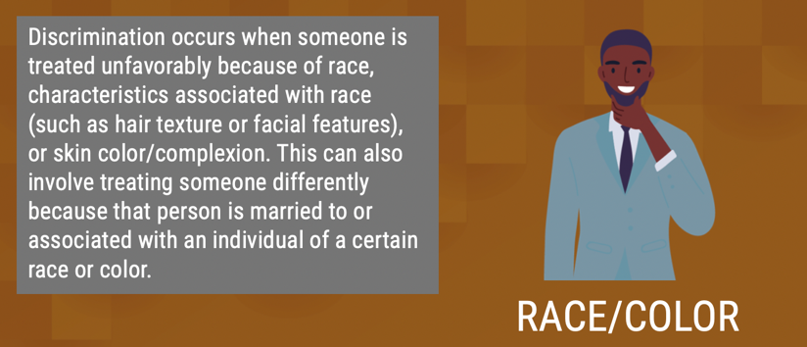
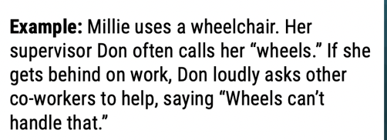
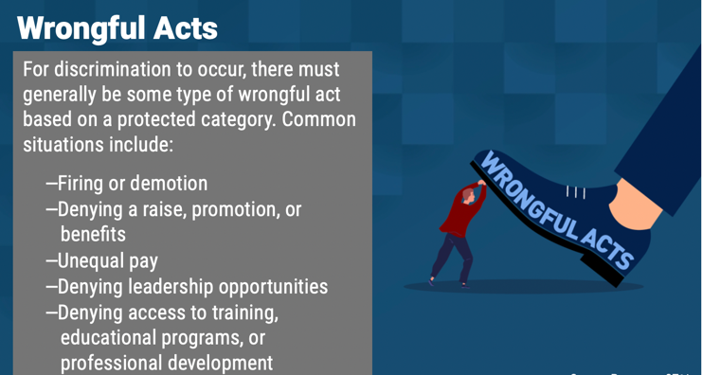
What is Harassment?
Harassment is threatening, insulting, and dehumanizing behavior that interferes with a student’s learning environment. It doesn’t matter if the person who engaged in such behavior was trying to be funny, or just being stupid, or didn’t intend to offend anyone.
Unlawful workplace harassment is a type of discrimination that demeans or threatens one or more employees on the basis of certain characteristics that are protected by law or by MVNU’s internal policies.
In my Biology class, these three students are always calling me “retarded” and “stupid” because of my ADHD. They even went so far as to accuse me of faking a learning disability to get out of doing work. They call me lazy.
They’ve kept me from working with their group and now no other lab groups want to work with me because of my “reputation” for being lazy. It’s hurt my grade since I can’t complete the lab work on my own.
This guy Chris is always using racial slurs like “gangster” or “ghetto” when referring to African Americans around friends. Last week I overheard him using these racial slurs in the dining hall, and I finally approached him. I asked him to stop using those kinds of words because they’re offensive. Shortly after confronting him, I went back to my dorm room and found a noose on my door. Today I found a note on my door saying “the KKK was here.”

Slide 11

What Is Discriminatory Harassment?
Prohibited Conduct
Discriminatory harassment can take many forms. It may be, but is not limited to: words, signs, jokes, pranks, intimidation, physical contact, or violence. It also may include harassment that is sexual in nature or directed at the gender of another (as in sexual harassment).
Do NOT create a HOSTILE environment!
Harassment may also be constituted by nonverbal acts that would also be punishable as, for example, vandalism, physical assault, or destruction of property. Other examples of harassment include epithets or "jokes" referring to an individual's group-based attributes; placement of offensive written or visual material on another's work area; offensive messages sent through email; and undesired physical contact, physical violence, or threat of same.
Is intended to insult or stigmatize an individual or an identifiable group?
Is it addressed directly to or at (though not necessarily in the presence of) the individual or individuals whom it insults or stigmatizes
Does it make use of words or nonverbal symbols that convey hatred or contempt for human beings on the basis of a protected characteristic?

Slide 12


Title IX – Sexual Harassment
    Quid Pro Quo
    Unwelcome Conduct
    Sexual Assault
    Dating Violence
    Domestic Violence
    Stalking
For reported behavior to qualify as Prohibited Conduct under the Title IX- Sexual Harassment it must meet all of the following threshold requirements:
  The conduct must have occurred against a person in the United States.
  The conduct must have occurred within the University’s education program or activity. For purposes of this provision, this means that the conduct must have occurred either (a) in a location, event, or circumstances over which MVNU exercised substantial control over both the respondent and the context in which the sexual harassment occurs or (b) in relation to a building owned or controlled by a student organization that is officially recognized by the MVNU.
  The complainant must be participating in or attempting to participate in the education program or activity of the University at the time the formal complaint is filed.

Slide 13

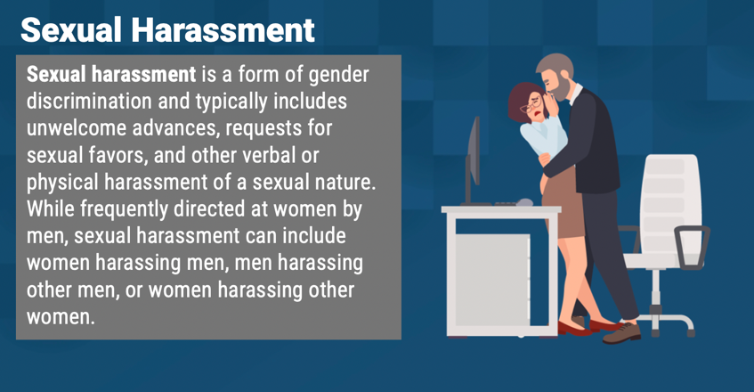
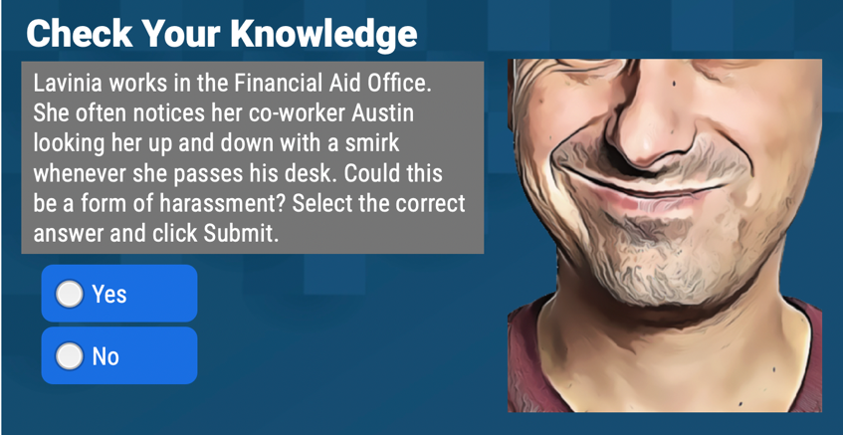
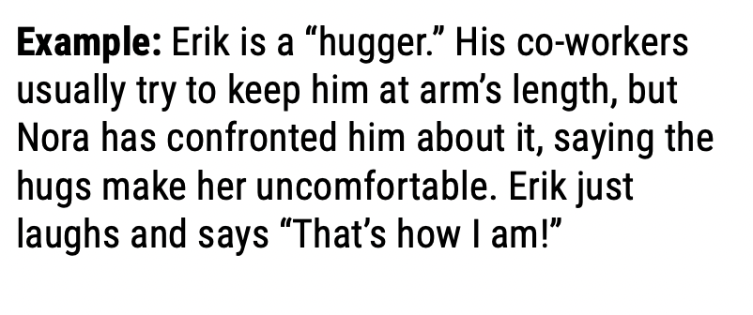
What is Sexual Harassment?
A group of male students sat together in the dining hall every day and “rated” female students’ attractiveness on a scale of one to ten. They shouted out their opinions and comments, including boos and hisses, and help up their fingers to publicly indicate a young woman’s numeric rating. They called out insults at some students, calling some “fat cows” and some “lesbos” or “dykes.”
Female students were angered and disgusted and some found it threatening. Other students were humiliated and avoided coming to the dining hall.
Inappropriate conduct or language that refers to or involves sex is considered sexual harassment. This can include solicitations for sex, jokes or comments, or inappropriate touching.

Slide 14

Title IX – Sexual Harassment
    Quid Pro Quo
    Unwelcome Conduct
    Sexual Assault
    Dating Violence
    Domestic Violence
    Stalking
Conduct that does not meet these threshold requirements is subject to a Title IX Dismissal but may still be resolved as a Non-Title IX Sexual Misconduct.
Non-Title IX Sexual Assault
Sexual and Gender-Based Harassment
Sexual Exploitation
Non-Title IX Domestic Violence
Non-Title IX Dating Violence
Non-Title IX Stalking
v
For reported behavior to qualify as Prohibited Conduct under the Title IX- Sexual Harassment it must meet all of the following threshold requirements:
  In US
  Within the University’s education program or activity
  Complainant must be participating in or attempting to participate in the education program or activity

Slide 15



PREGNANCY ACCOMMODATIONS AND RELATED CONDITIONS FOR STUDENTS AND EMPLOYEES
MVNU, through the Office of Civil Rights, supports pregnant students, faculty, and staff so they can achieve academic and work success while pregnant, recovering from birth of a child, caring for a newborn, and nursing an infant. The applicable federal laws pertaining to pregnancy at MNVU are stated below:
  Title IX
  Title VII
  ADA/Section 504)
  Pregnancy Discrimination Act prohibits discrimination on the basis of pregnancy, childbirth, or related medical conditions.
Be a Good Neighbor

Slide 16

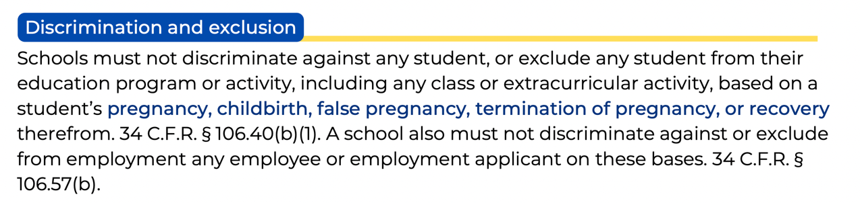


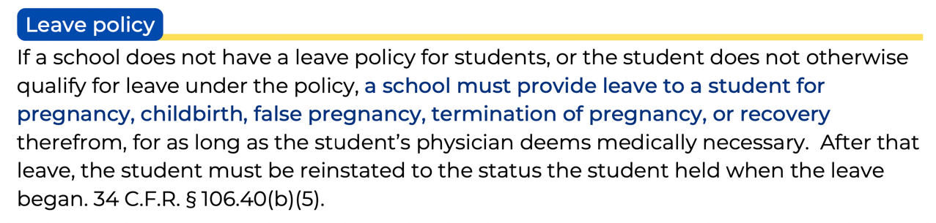

PREGNANCY ACCOMMODATIONS AND RELATED CONDITIONS FOR STUDENTS AND EMPLOYEES
Be a Good Neighbor
A school must ensure that teachers’ policies and practices do not discriminate against students because of pregnancy and related conditions. For example, a teacher may not refuse to allow a student to submit work after missing a deadline because of absences due to pregnancy or childbirth. Additionally, if a teacher’s grading is based in part on class attendance or participation, the student should be allowed to earn the missed credits and be reinstated to the student’s pre-leave status. OCR Pamphlet at 11.

Slide 17
PREGNANCY ACCOMMODATIONS AND RELATED CONDITIONS FOR STUDENTS AND EMPLOYEES
TITLE IX ADJUSTMENTS
Adjustments are time-limited for the period of the documented “medical necessity” per Title IX. They refer to options during and after pregnancy that provide for equitable access and ability to fully participate in academic programs, activities, practicums/field placements, and athletics.
Adjustments extend to parenting and primary caretaker of infant, and may include conditions arising from pregnancy, complicating pregnancy or resultant from pregnancy that might not otherwise be considered a disability/condition.
ADA/504 ACCOMMODATIONS
Accommodations require the presence of a “qualified” disability and/or condition per ADA/504. Pregnancy, alone, is not a disability. Pregnancy may be considered a temporary disability in certain circumstances under Section 504, or it may be considered a disability when one or more impairments related to pregnancy are present OR when a condition arising from pregnancy becomes long-lasting (i.e.: postpartum depression or gestational diabetes that becomes Type II) under ADA.
SUPPORTS
Extended deadlines Flexible exam scheduling
Excused absences
Grades of incomplete
Temporary parking in a closer location
Breaks for nursing/pumping
Job modifications, including reassignment to others of non-essential duties
Modified work schedule
Leave of absence Temporary assignment to a light duty position
Be a Good Neighbor
The Pregnant Scholar
Resource
https://thepregnantscholar.org/title-ix-basics/

Slide 18



MVNU prohibits discrimination and harassment on the basis of disability.
It is covered in the Civil Rights Policy Resolving Complaints under the Disabilities Act and the Rehabilitation Act of 1973.
STUDENTS: Further information is available on MVNU’s Accessibility Student Policy webpage.
EMPLOYEES: Appropriate handbooks.
Grievance Procedures are found at www.mvnu.edu/titleix.
ADA / Section 504
Accommodations are provided under the law.

Slide 19



To address harassment, you have to be able to recognize harassment: Harassment can occur in many ways and many different places, and it can be perpetuated by a wide range of individuals.
The problems is real: All occurrences are serious and unacceptable. Every student has the right to a respectful educational environment and every employee has the right a respectful work environment that is free from discrimination and harassment.
You play a vital role in preventing and stopping harassment: Whether you are standing up for yourself, supporting someone else, or simply not joining in, you set the example for others.
- United Educators

Slide 20



Important Things to Know
How to report? ONLINE FORM OR IN PERSON
What to report? PROHIBITED CONDUCT
Who must report? MANDATED REPORTERS
Who are confidential resources? CAMPUS PASTORS, NURSE, COUNSELORS
What are supportive measures? NON-PUNITIVE SERVICES
What are the processes? FORMAL / INFORMAL
What is consent? CLEAR, KNOWING, VOLUNTARY
What is Bystander Intervention? STAND UP & SPEAK UP

Slide 21





CAMPUS POSTER
STOP
  Stop the discrimination or harassment
PREVENT
  Prevent the reoccurrence
REMEDY
  Remedy the effect
Take a look at PROHIBITED CONDUCT under the policy.
What Do YOU Report?
Prohibited
Conduct

Slide 22


Responding to Disclosure
Writing an Incident Report
Clarify role as a Mandated Reporter.
Remind them that you must report to the Civil Rights Director, but talking to the CRD is optional.
The CRD will keep the disclosure private.
Do NOT investigate! Do NOT mediate!
Listen. Support. Refer. Measures. Document.
Use the Incident Report Form online
Fill out the rest of the form to the best of your ability. As a mandated reporter you cannot report anonymously.
Be clear. Use first/last names. Avoid pronouns.
Report versus Formal Complaint
Complainants decide what, if anything, will happen.

Slide 23



CIVIL RIGHTS WEBPAGE: mvnu.edu/titleix/

Slide 24
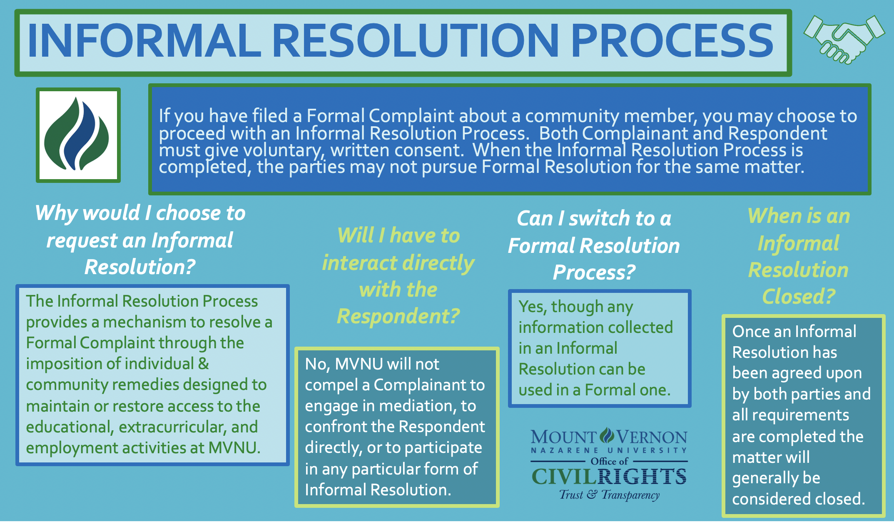

Slide 25

Confidential Resources
Directly access numbers from “How to Get Help” tab on webpage
On Campus
Campus Counseling Center
Campus Pastor and Associate Pastor
Student Health Services
Off Campus
New Directions Domestic Abuse & Rape Crisis Center
Knox County Victim’s Assistance
National Domestic Violence Hotline
Ohio Sexual Violence Domestic Violence Hotline
Ohio Hispanic Coalition Domestic Violence Hotline
More Resources at mvnu.edu./titleix

Slide 26

SUPPORTIVE MEASURES
Amnesty for Personal Use of Alcohol or Other Drugs
The University seeks to remove barriers to reporting. MVNU will offer any student who reports or experiences Prohibited Conduct limited immunity from being charged for policy violations related to the personal ingestion of alcohol or other drugs, provided that any such violations did not and do not place the health and safety of any person at risk. However, we may pursue educational or therapeutic remedies for those individuals, rather than punishment. MVNU desires to encourage its community members to offer help to others in need.
Regardless of when, where or with whom the conduct occurred, the University will offer resources and assistance to any individual who has been affected by Prohibited Conduct.
Non-disciplinary, non-punitive individualized services offered to both the complainant and respondent as appropriate, reasonably available, and without fee or charge.
NON-PUNITIVE SERVICES

Slide 27



Consent
Consent is a critical part of understanding and eliminating Sexual Misconduct
How does consent work in real life?
When you’re engaging in intimate activity, the most important part of consent is communication. Consent needs to happen every time and in every instance. Giving consent for one activity, one time, does not mean giving consent for increased or recurring sexual contact. For example, agreeing to kiss someone doesn’t give that person permission to remove your clothes.
CONSENT EXAMPLE: Communicating when you change the type or degree of intimate activity with phrases like “Is this OK?” Always, clearly communicate with your partner that you are no longer comfortable with this activity and wish to stop.
NO CONSENT EXAMPLE: Assuming you have permission to engage in intimate behavior because you’ve done it in the past
Must be informed, knowing and voluntary – freely given through clear words or action​
Cannot use force, threats, intimidating behavior, or coercion (unreasonable/persistent pressure).​
It cannot be given by someone known to be – or who should be known to be mentally or physically incapacitated.​
Consent requires the
following conditions: ​
1. All parties are fully conscious.​
2. All parties are equally free to act.​
3. All parties have positively and
clearly communicated their intent.

Slide 28


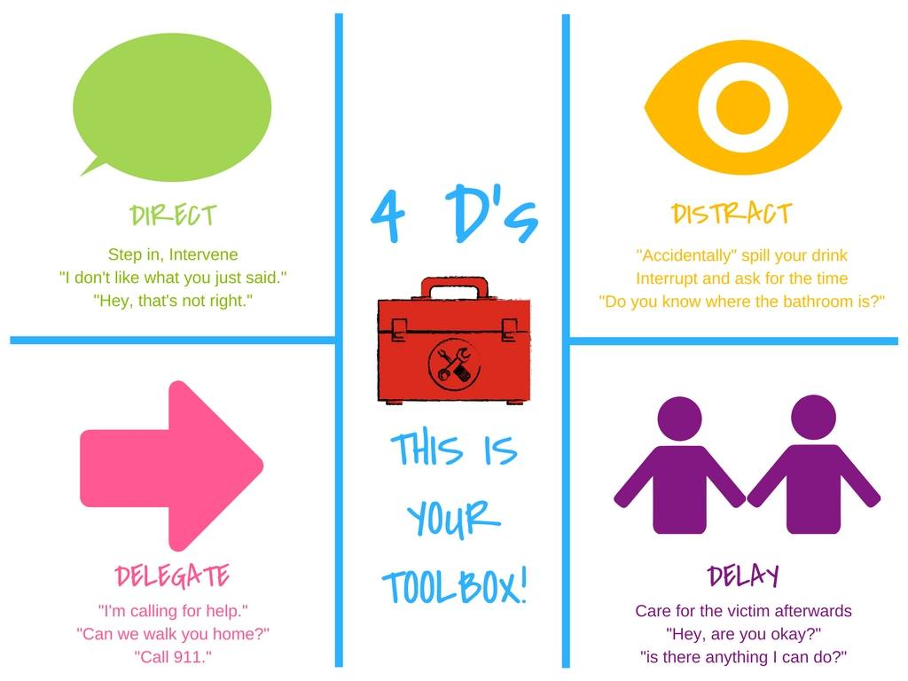

Bystander Intervention
Be a part of the SOLUTION

Slide 29


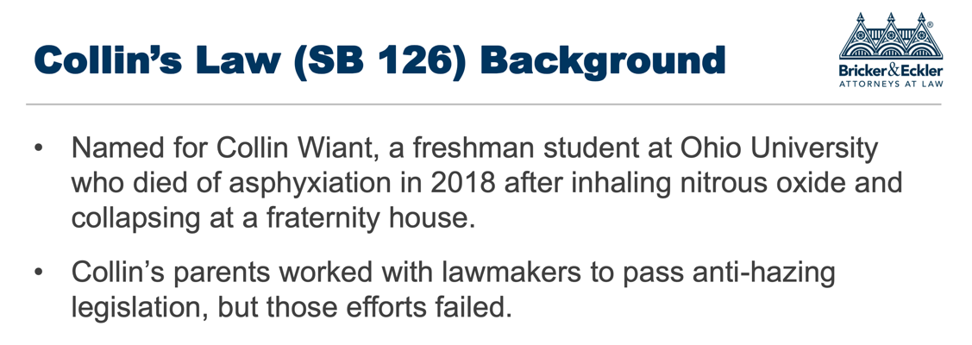
ANTI-HAZING POLICY
WHAT IS HAZING?
The Ohio Revised Code, Section 2903.31 defines hazing as: "doing any act or coercing another, including the victim, to do any act of initiation into any student or other organization or any act to continue or reinstate membership in or affiliation with any student or other organization that causes or creates a substantial risk of causing mental or physical harm to any person, including coercing another to consume alcohol or a drug of abuse, as defined in section 3719.011 of the Revised Code.
Notes:
Here’s an overview of how our discipline process works. [Click] (I’m loosing steam…)
Read. [Click]
Read [Click]
Read [Click]
Read [Click]

Slide 30

WHAT IS HAZING AT MVNU?
MVNU considers hazing to be any act which endangers the mental or physical health or safety of a student, or which destroys or removes public or private property for the purpose of initiation, admission into, or affiliation with, or as a condition for continued membership in a group or organization, whether the person subjecting to such behavior participates willingly or not.
Hazing acts may be physical, mental, emotional or psychological, which subjects another, to anything which may abuse, mistreat, degrade, humiliate, discomfort, ridicule, harm, or intimidate.
STUDENT REPORTING
• Student Life Office
• Campus Safety
• Anonymous reports via Hazing Reporting Form
• If an emergency call 911.
EMPLOYEE REPORTING
“Mandatory Reporter” – not anonymous
Employee of MVNU
Any volunteer acting in an official capacity who advises or coaches student organizations
If a student does not complete this educational programming, they are PROHIBITED from participating in a recognized organization until the programming is completed.

Slide 31
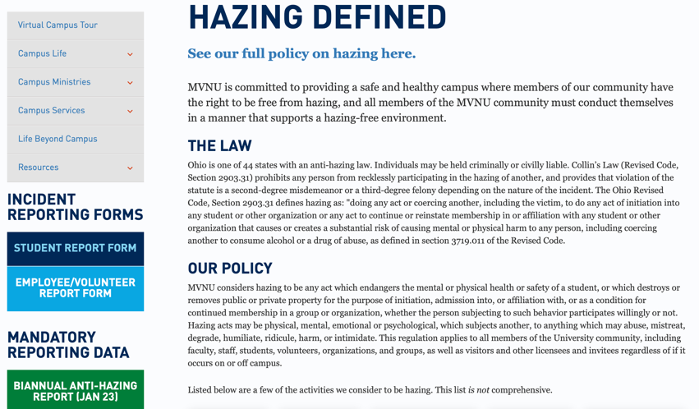

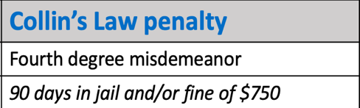
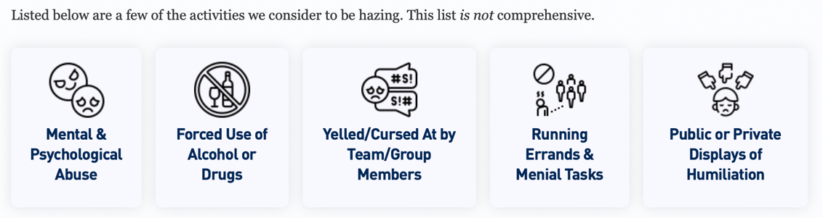
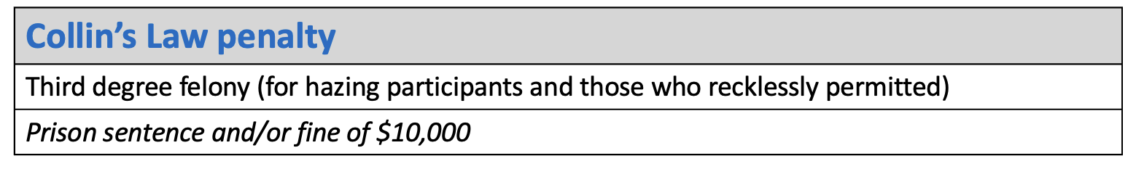

Hazing Penalties
Check out the Webpage @
https://www.mvnu.edu/studentlife/campuslife/hazing
RECKLESS PARTICIPATION
Prohibits administrators, employees, faculty members, teachers, consultants, alumni or volunteers from recklessly permitting the hazing of any person associated with an institutional organization.
COERCEED CONSUMPTION
Prohibits hazing that involves “coerced consumption of alcohol or drugs of abuse resulting in serious physical harm to that person.”

Slide 32


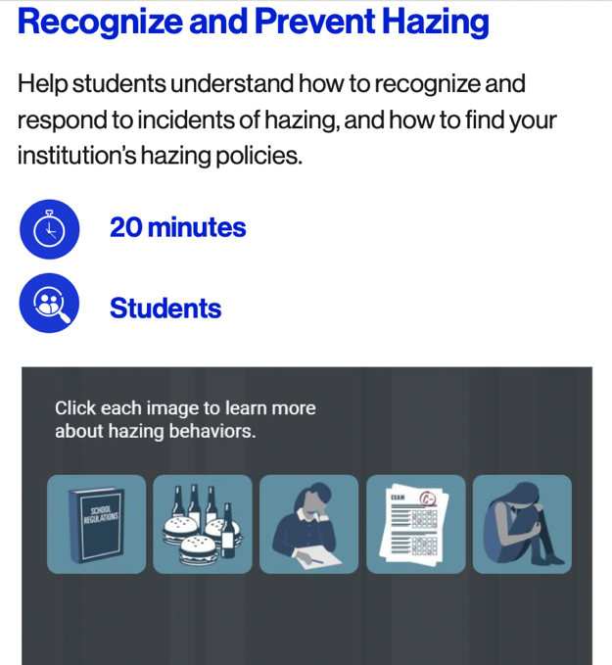
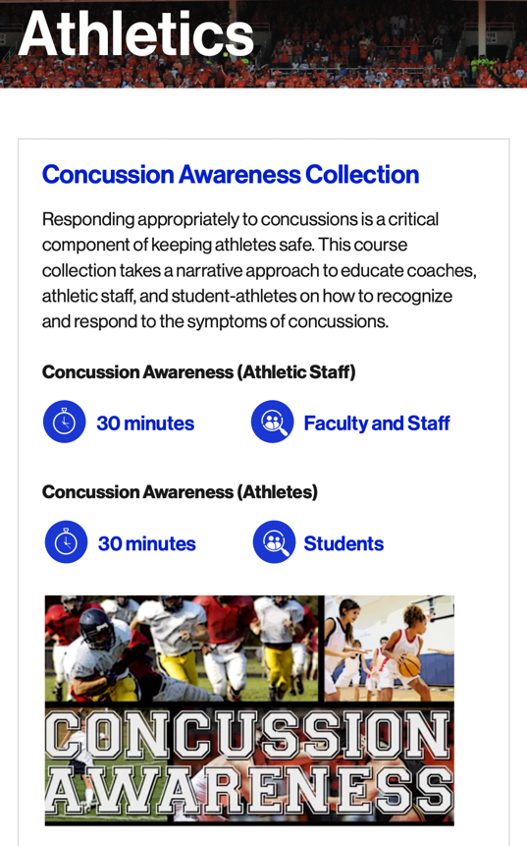
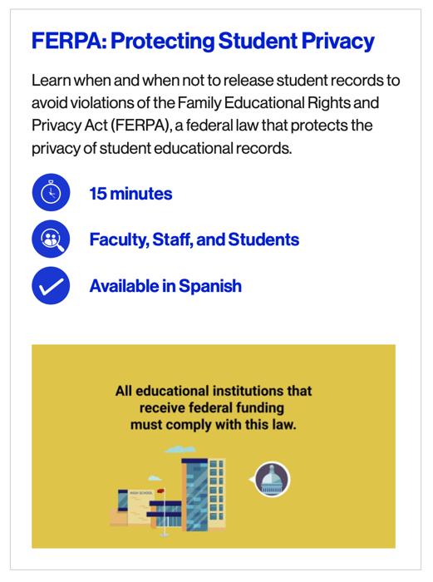







Slide 33

Scripture supports our training!
“You, my brothers and sisters, were called to be free. But do not use your freedom to indulge the flesh; rather, serve one another humbly in love. For the entire law is fulfilled in keeping this one command: “Love your neighbor as yourself.”
Gal. 5:13-14 (NIV)
Be a Good Neighbor

